Slide 1
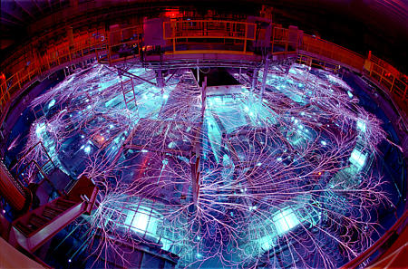



Recent Fusion-Related Results in Drekar
Edward Phillips
Trilinos User-Developer Group Meeting 2023
Advances in Computation Mechanics, Austin, Texas, 10/22/2023
SAND#2023-11657C
Notes:
John N. Shadid, Jesus Bonilla, Xian-Zhu Tang, Peter Ohm, Edward Phillips, Michael Crockatt, Roger Pawlowski
A stabilized finite element (FE) discretization of the single fluid low Mach number compressible resistive magnetohydrodynamics (MHD) equations is presented. The resulting method is inteneded to model macroscopic plasma instabilities and disruptions in complex 3D Tokamak devices used for exploring magnetic confinement fusion (MCF). The stabilized FE description is developed from a variational multiscale stabilization (VMS) approach to handle different shortcomings of the standard Galerkin FE discretization. The resulting VMS FE operators are used for stabilization of strongly convective flow effects, and for stabilizing the saddle point structure of the magnetic field elliptic divergence cleaning term, and the low Mach number nearly incompressible flow limit. The multiphysics block structure of the Newton linearized discrete system will be described along with the challenges it induces on scalable iterative solvers. The results of several numerical tests in evaluating the effectiveness of the VMS formulation will be presented. These will include computations of a vertical displacement event (VDE) and a few plasma instabilities in realistic ITER geometries.

Slide 2

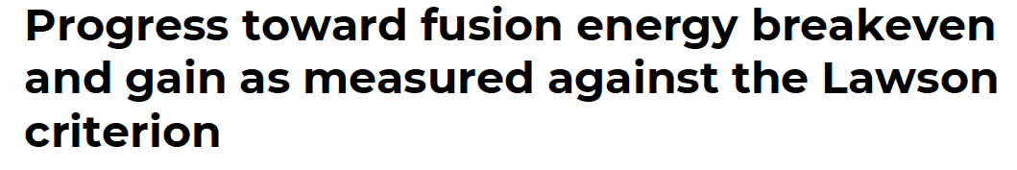
Collaborators
Jesus Bonilla and Xian-Zhu Tang, Los Alamos National Lab
Peter Ohm, RIKEN, Japan
John Shadid, Michael Crockatt, Roger Pawlowski,
Ray Tuminaro, Jonathan Hu, Sandia National Labs
Three useful resources for fusion energy for students:
https://www.cpepphysics.org/
Princeton Plasma Physics Laboratory
2021 Introduction to Fusion Energy and Plasma Physics Course
https://suli.pppl.gov/2021/course/
Wurzel, Hsu, Physics of Plasmas 29, 062103 (2022)
Notes:
1
R&A Confirmed
Your request has been submitted for review and approval. Your tracking (document) number is: 5314153.

Slide 3
Overview of Drekar
Drekar is a finite element based multiphysics code built using Trilinos components with a strong emphasis on implicit time integration methods and linear solvers
Drekar
Physics
Advection-Diffusion-Reaction
Fluid Dynamics
Electromagnetics
Solids
Magnetohydrodynamics
Generalized Ohm’s Law
Multifluid Plasma
Panzer
Discretization + Algorithms
Finite Elements (nodal, edge, face, etc.)
Stabilization (VMS, AFC, etc.)
Time Integration (implicit, explicit, IMEX)
Nonlinear Solvers
Linear Solvers
Preconditioners
Adjoints + Optimization
Intrepid2
Tempus
NOX
Belos
Teko, MueLu, Ifpack2
Sacado
Phalanx

Slide 4
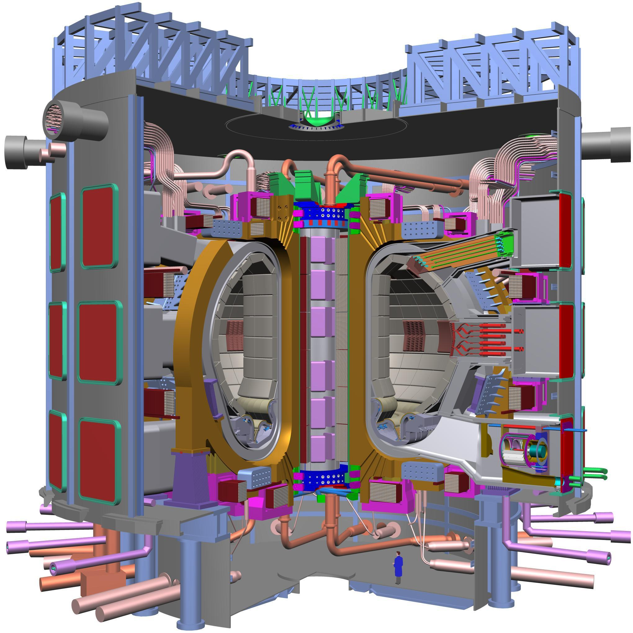
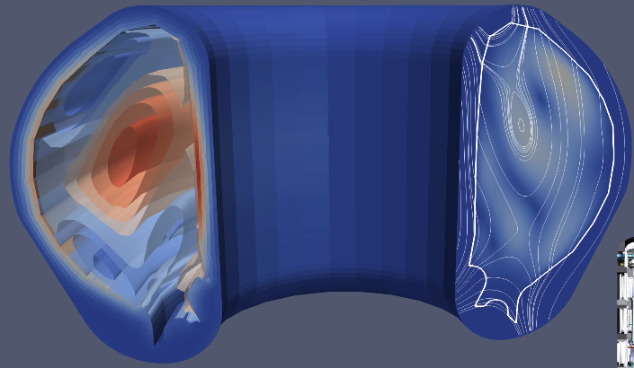
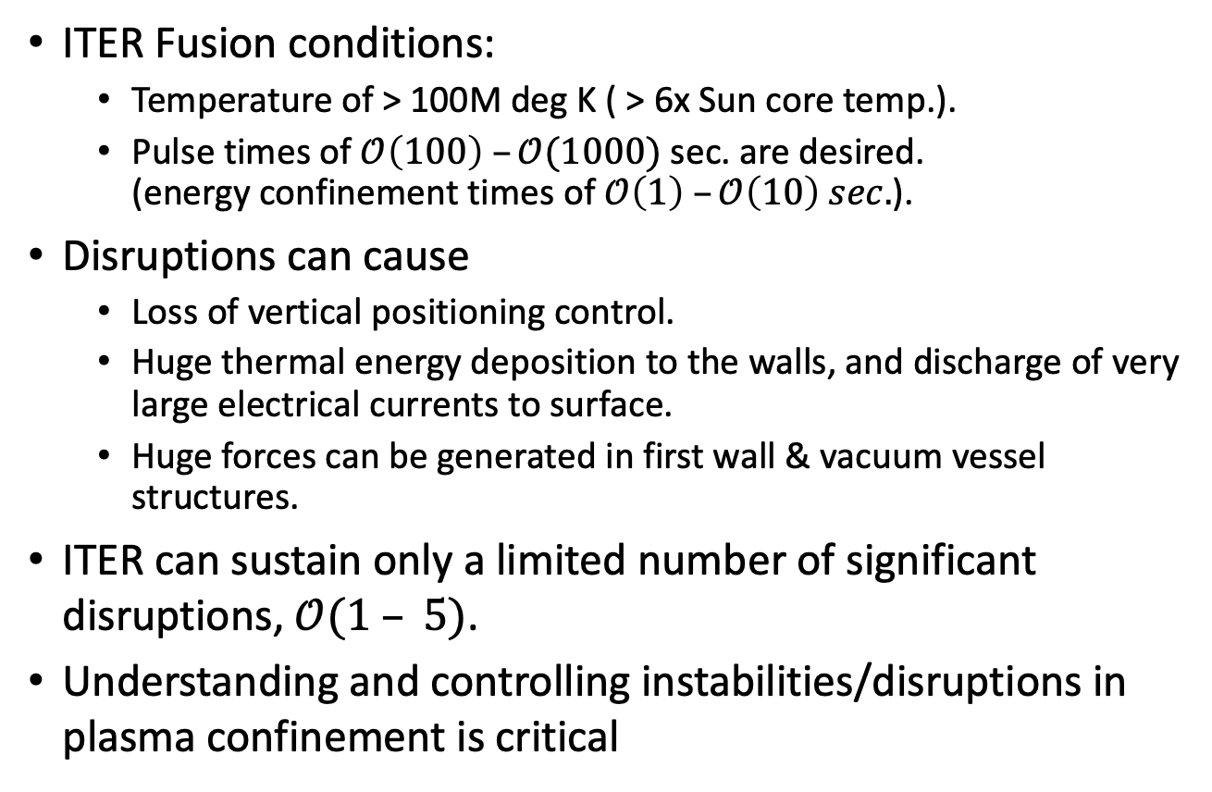
Motivation
ITER Fusion conditions:
Temperature of > 100M deg K ( > 6x Sun core temp.).
Pulse times of $𝒪\left(100\right) –𝒪(1000)$sec. are desired. (energy confinement times of $𝒪\left(1\right) –𝒪\left(10\right) sec.$).
Disruptions can cause
Loss of vertical positioning control.
Huge thermal energy deposition to the walls, and discharge of very large electrical currents to surface.
Huge forces can be generated in first wall & vacuum vessel structures.
ITER can sustain only a limited number of significant disruptions, $𝒪(1 – 5)$.
Understanding and controlling instabilities/disruptions in plasma confinement is critical
ITER Tokamak
Vertical Displacement Event (VDE) in ITER Tokamak Plasma and Wall Geometry (Drekar sim.)

Slide 5
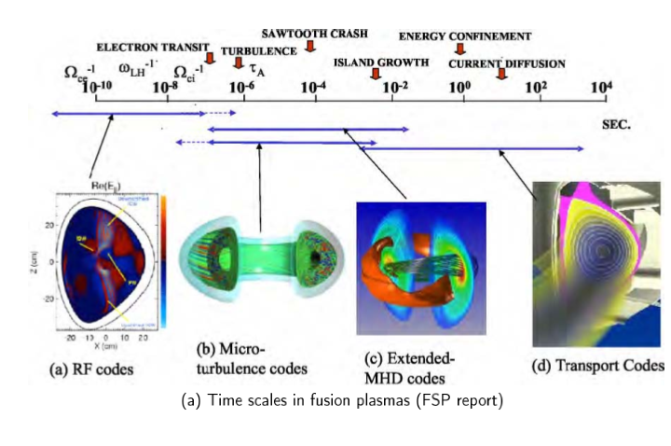
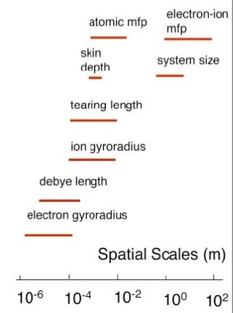
Goal
Analyze macroscopic plasma 3D behavior/instabilities under ITER conditions.
DOE Office of Science ASCR/OFES Reports: Fusion Simulation Project Workshop Report, 2007, Integrated System Modeling Workshop 2015
Implicit time integration (overstep fastest time scales/CFL on refined meshes).
Stabilized FE formulation (resolution, higher-order accuracy, enforcing constraints)
(currently) Single-fluid compressible visco-resistive MHD.
Newton-Krylov + multiphysics block preconditioners (Highly scalable, efficient and robust solvers)

Slide 6
A Reduced length-scale/time scale representation; Basic single fluid
Resistive MHD [e.g. 3D H(grad) Variational Multiscale (VMS) Stabilized FE]
u
P
T
B
Resistive MHD Model in Conservative Form
Sound wave off diagonal coupling, and
nearly incompressible
flow limit ( )
Alfven wave strong off diagonal coupling
Elliptic constraint – infinite wave speed
MHD Wave speeds
Here c_{h} is for elliptic divergence cleaning
Notes:
MHD couples a Navier-Stokes type system for the ion momentum, mass conservation and energy to Maxwell’s equations.
Faraday’s law and Ampere’s Law (neglecting displacement currents) and a generalized Ohm’s law for the electric field.
7 waves
{\bf R_v} = \noindent \rho \frac{\partial {\bf v}}{\partial t} + \rho ({\bf v} \cdot \nabla {\bf v}) - \nabla \cdot ( {\bf T} + {\bf T}_{\bf M} ) -\rho {\bf g} = 0
{\bf R_u} = \noindent \rho \frac{\partial {\bf u}}{\partial t} + \rho ({\bf u} \cdot \nabla {\bf u}) - \nabla \cdot ( {\bf T} + {\bf T}_{\bf M} ) -\rho {\bf g} = 0
{\bf R_u} = \frac{\partial \rho {\bf u}}{\partial t} + \nabla \cdot [ \rho {\bf u} \otimes {\bf u} - ({\bf T} + {\bf T}_M) ] + 2 \rho\Omega \times {\bf u} - \rho {\bf g} = {\bf 0}
R_P = \frac{\partial \rho}{\partial t} + \nabla \cdot (\rho {\bf u}) = 0
{\bf R_B} = \frac{\partial {\bf B}}{\partial t} -\nabla \times ({\bf u} \times {\bf B}) + \nabla \times ( \frac{\eta}{\mu_0} \nabla \times {\bf B}) = {\bf 0}.
{\bf T} & = & -P {\bf I} + {\bf \Pi} = -P {\bf I} - \frac{2}{3} \mu (\nabla \cdot {\bf u}) {\bf I} + \mu [\nabla {\bf u} + \nabla {\bf u}^T ]
{\bf T}_{\bf M} & = & \frac{1}{\mu_0} {\bf B} \otimes {\bf B} - \frac{1}{2 \mu_0} \| {\bf B} \|^2 {\bf I}
{\bf B} = \nabla \times {\bf A}
R_e = \frac{\partial (\rho e)}{\partial t} + \nabla \cdot \left[ \rho {\bf v} e + {\bf q} \right] - {{\bf T} : {\nabla {\bf v}}} - \eta \| {\frac{1}{\mu_0} \nabla \times {\bf B}} \|^2 = { 0}
R_{A_z} = \frac{\partial A_z}{\partial t} + {\bf u} \cdot \nabla A_z - \frac{\eta}{\mu_0} \nabla^2 A_z +E^0_z= 0.
%{\bf R_B} = \frac{\partial B}{\partial t} + \nabla \cdot \left[ {\bf u} \otimes {\bf B} - { \bf B} \otimes {\bf u} - \frac{\eta}{\mu_0} \left(\nabla {\bf B} - (\nabla {\bf B})^T) + \psi {\bf I} \right] = {\bf 0}
%R_{\psi} = \nabla \cdot {\bf B} = 0

Slide 7
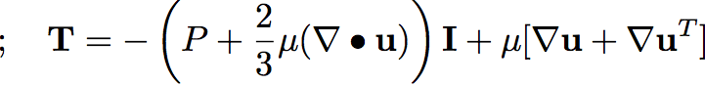
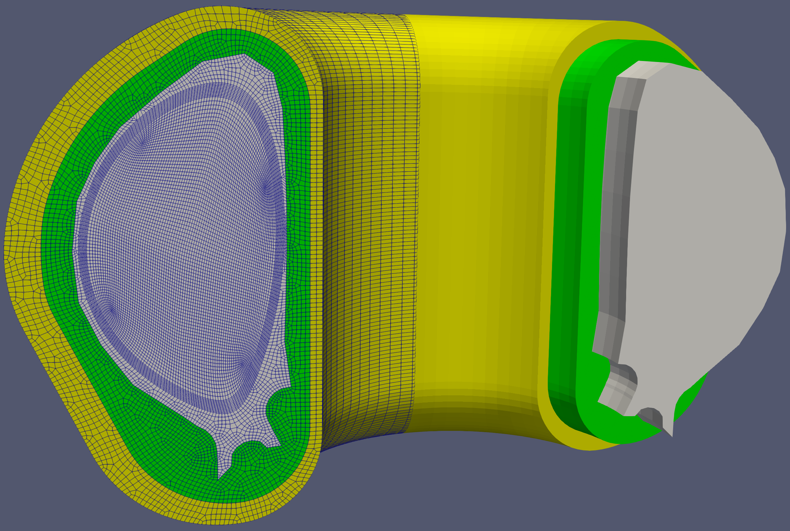
Heterogeneous Multiphysics: 3D implicit unstructured FE visco-resistive MHD in ITER geometry
Plasma region: visco-resistive MHD
Momentum
Mass
Internal energy
Magnetic induction
Solid walls and vacuum regions
Internal energy
Magnetic induction
Heterogeneous Physics Regions
Outer perfect conducting wall
Vacuum region
Solid 1st wall
Plasma region

Slide 8
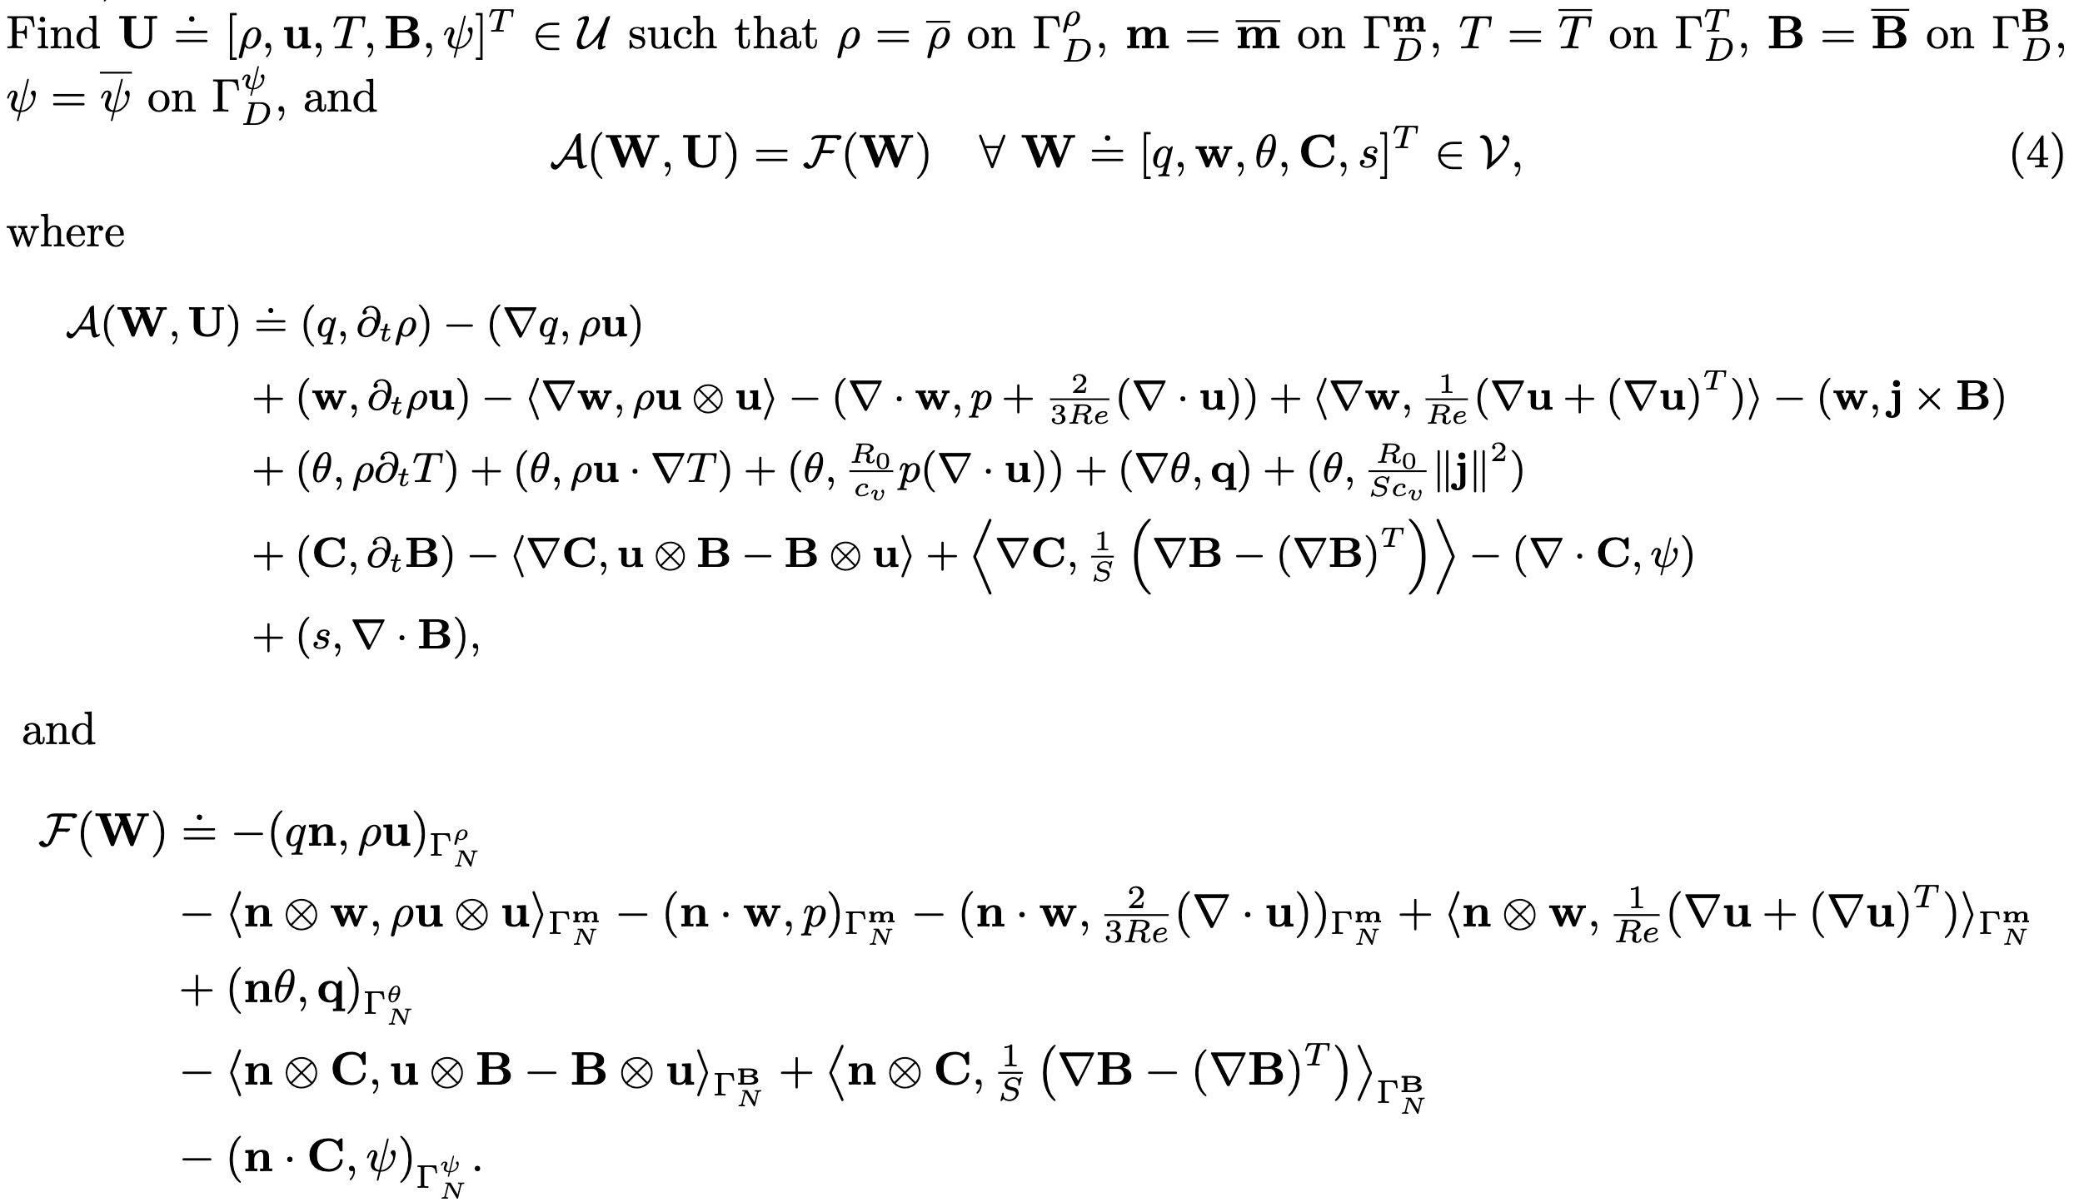
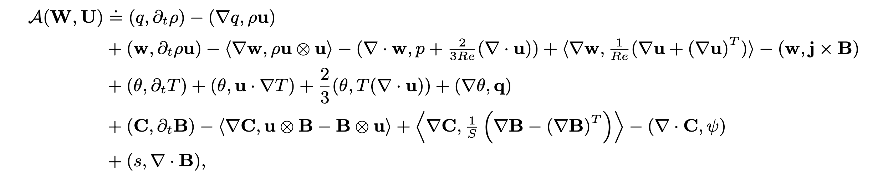
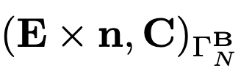
Discretization
Finite element discretization (Galerkin terms)
Deficiencies of Galerkin Weak Form:
Equal-order interpolation have stability problems for saddle point prbs. (LBB condition, see .e.g. Gunzburger 1989)
Induction – div B = 0; Lagrange multiplier coupling
Strong guide field (large B) produces an incompressible flow limit type response
and a saddle point like structure (e.g. Stokes-like behavior for )
Strong convective transport and large unresolved gradients can produce unphysical spatial oscillations (internal / boundary layers).
For unresolved high-wavenumber signals aliasing of energy into lower-wavenumber resolved components

Slide 9
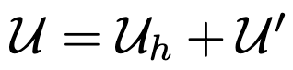
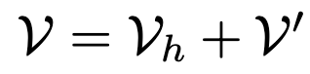
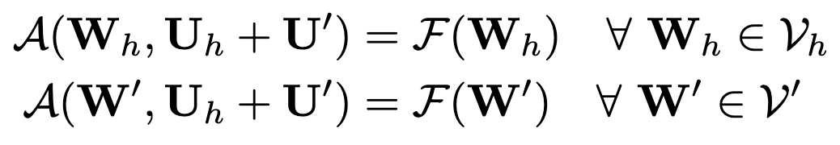
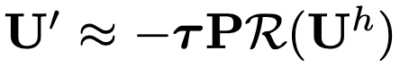
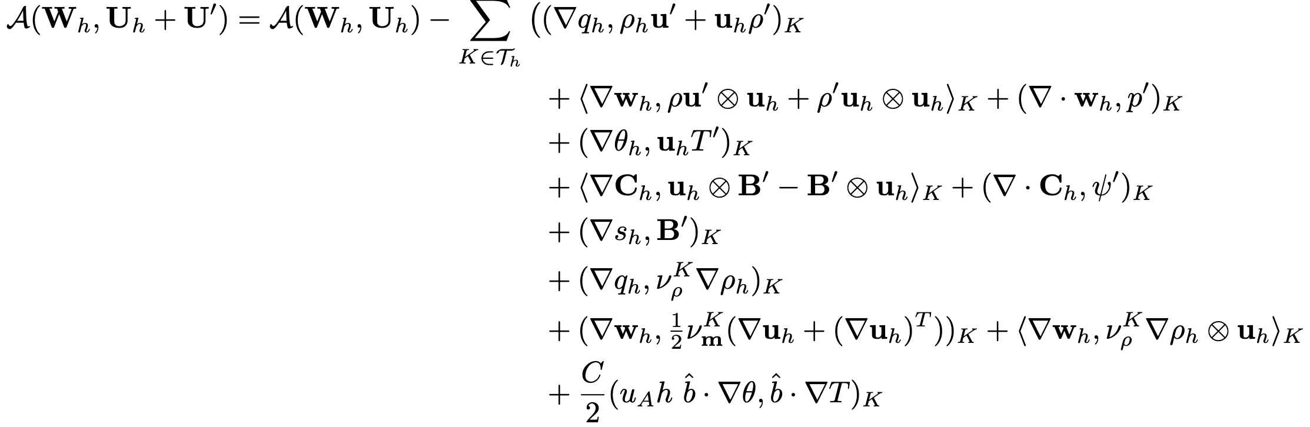
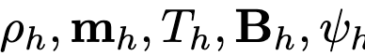
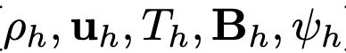
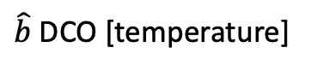
Brief Outline Following Variational Multiscale (VMS) Approach
VMS: T.J.R Hughes et. al.; & VMS MHD: Codina et. al., JS et. al.
Upwinding and saddle point stabilization
Let us split the solution and test spaces in resolved and unresolved scales, i.e., and , thus we have
not resolved, modeled by
I.e. sub-grid / unresolved scales driven by residual resolved scales of strong from PDEs, variationally consistent
VMS + additional optional DCO terms are included for enhanced stability
VMS
DCO LLF [density]
DCO R(s) [momentum]
)
$\hat{b}$DCO [temperature]
First order cG finite elements for and second order finite elements .
Bonilla, S, Tang, Crockatt, Ohm, Phillips, Pawlowski, Conde, Beznosov, On a Fully-implicit VMS-stabilized FE Formulation for Low Mach Number Compressible Resistive MHD with Application to MCF, Comput. Methods Appl. Mech. Engrg. 2023
S, Pawlowski, Cyr, Tuminaro, Chacon, Weber, Scalable Implicit Incompressible Resistive MHD with Stabilized FE and Fully-coupled Newton-Krylov-AMG, Comput. Methods Appl. Mech. Engrg. 304, 1–25, 2016

Slide 10
Preliminary Results

Slide 11
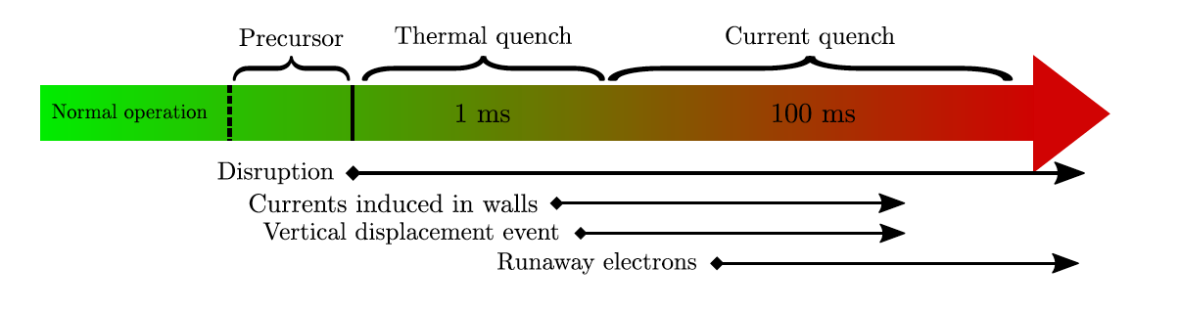
Vertical displacement events (VDEs) are major disruption events occurring in tokamaks when vertical stability control is lost.
These events cause large currents to flow in the vessel and other adjacent metallic structures.
Cold VDE, Thermal Quench – a fast internal energy loss (i.e. Temperature drop)
Initial equilibrium force balance is lost:
Loss of vertical position control
Temperature drop => resistivity increases => plasma current drops + ohmic to runaway electron current conversion.
Plasma current drop, new sequence of quasi-steady ”equilibriums” => magnetic field rearrangement. i.e. VDE
VDE => large halo currents produced in walls and large EM forces
Notes:
MHD couples a Navier-Stokes type system for the ion momentum, mass conservation and energy to Maxwell’s equations.
Faraday’s law and Ampere’s Law (neglecting displacement currents) and a generalized Ohm’s law for the electric field.
7 waves
{\bf R_u} = \noindent \rho \frac{\partial {\bf u}}{\partial t} + \rho ({\bf u} \cdot \nabla {\bf u}) - \nabla \cdot ( {\bf T} + {\bf T}_{\bf M} ) -\rho {\bf g} = 0
{\bf R_u} = \frac{\partial \rho {\bf u}}{\partial t} + \nabla \cdot [ \rho {\bf u} \otimes {\bf u} - ({\bf T} + {\bf T}_M) ] + 2 \rho\Omega \times {\bf u} - \rho {\bf g} = {\bf 0}
R_P = \frac{\partial \rho}{\partial t} + \nabla \cdot (\rho {\bf u}) = 0
{\bf R_B} = \frac{\partial {\bf B}}{\partial t} -\nabla \times ({\bf u} \times {\bf B}) + \nabla \times ( \frac{\eta}{\mu_0} \nabla \times {\bf B}) = {\bf 0}.
{\bf T} & = & -P {\bf I} + {\bf \Pi} = -P {\bf I} - \frac{2}{3} \mu (\nabla \cdot {\bf u}) {\bf I} + \mu [\nabla {\bf u} + \nabla {\bf u}^T ]
{\bf T}_{\bf M} & = & \frac{1}{\mu_0} {\bf B} \otimes {\bf B} - \frac{1}{2 \mu_0} \| {\bf B} \|^2 {\bf I}
{\bf B} = \nabla \times {\bf A}
R_e = \frac{\partial (\rho e)}{\partial t} + \nabla \cdot \left[ \rho {\bf v} e + {\bf q} \right] - {{\bf T} : {\nabla {\bf v}}} - \eta \| {\frac{1}{\mu_0} \nabla \times {\bf B}} \|^2 = { 0}
R_{A_z} = \frac{\partial A_z}{\partial t} + {\bf u} \cdot \nabla A_z - \frac{\eta}{\mu_0} \nabla^2 A_z +E^0_z= 0.
%{\bf R_B} = \frac{\partial B}{\partial t} + \nabla \cdot \left[ {\bf u} \otimes {\bf B} - { \bf B} \otimes {\bf u} - \frac{\eta}{\mu_0} \left(\nabla {\bf B} - (\nabla {\bf B})^T) + \psi {\bf I} \right] = {\bf 0}
%R_{\psi} = \nabla \cdot {\bf B} = 0

Slide 12
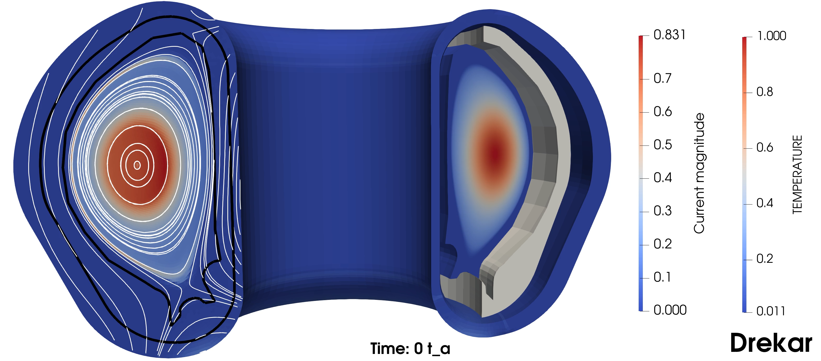
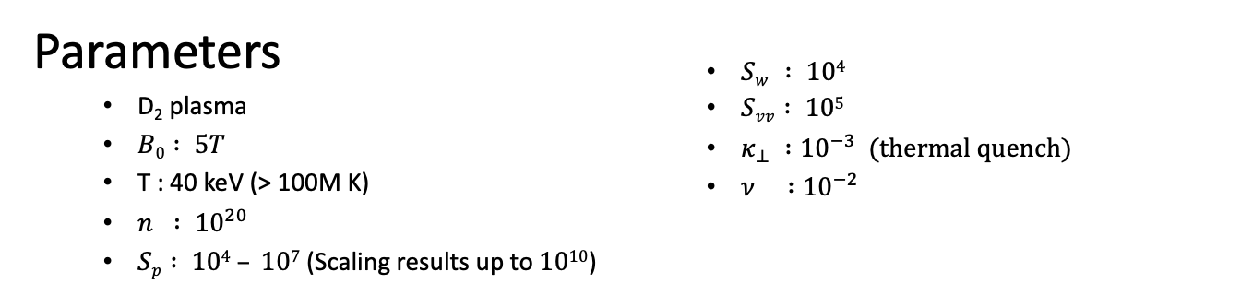
Vertical Displacement Event (VDE) II
Parameters
D₂ plasma
$B0 : 5T$
T : 40 keV (> 100M K)
$n : {10}^{20}$
$Sp : 104 – 107$ (Scaling results up to $1010$)
$Sw : 104$
$Svv : 105$
$κ_{⊥} :{10}^{−3}$ (thermal quench)
$ν :{10}^{−2}$

Slide 13
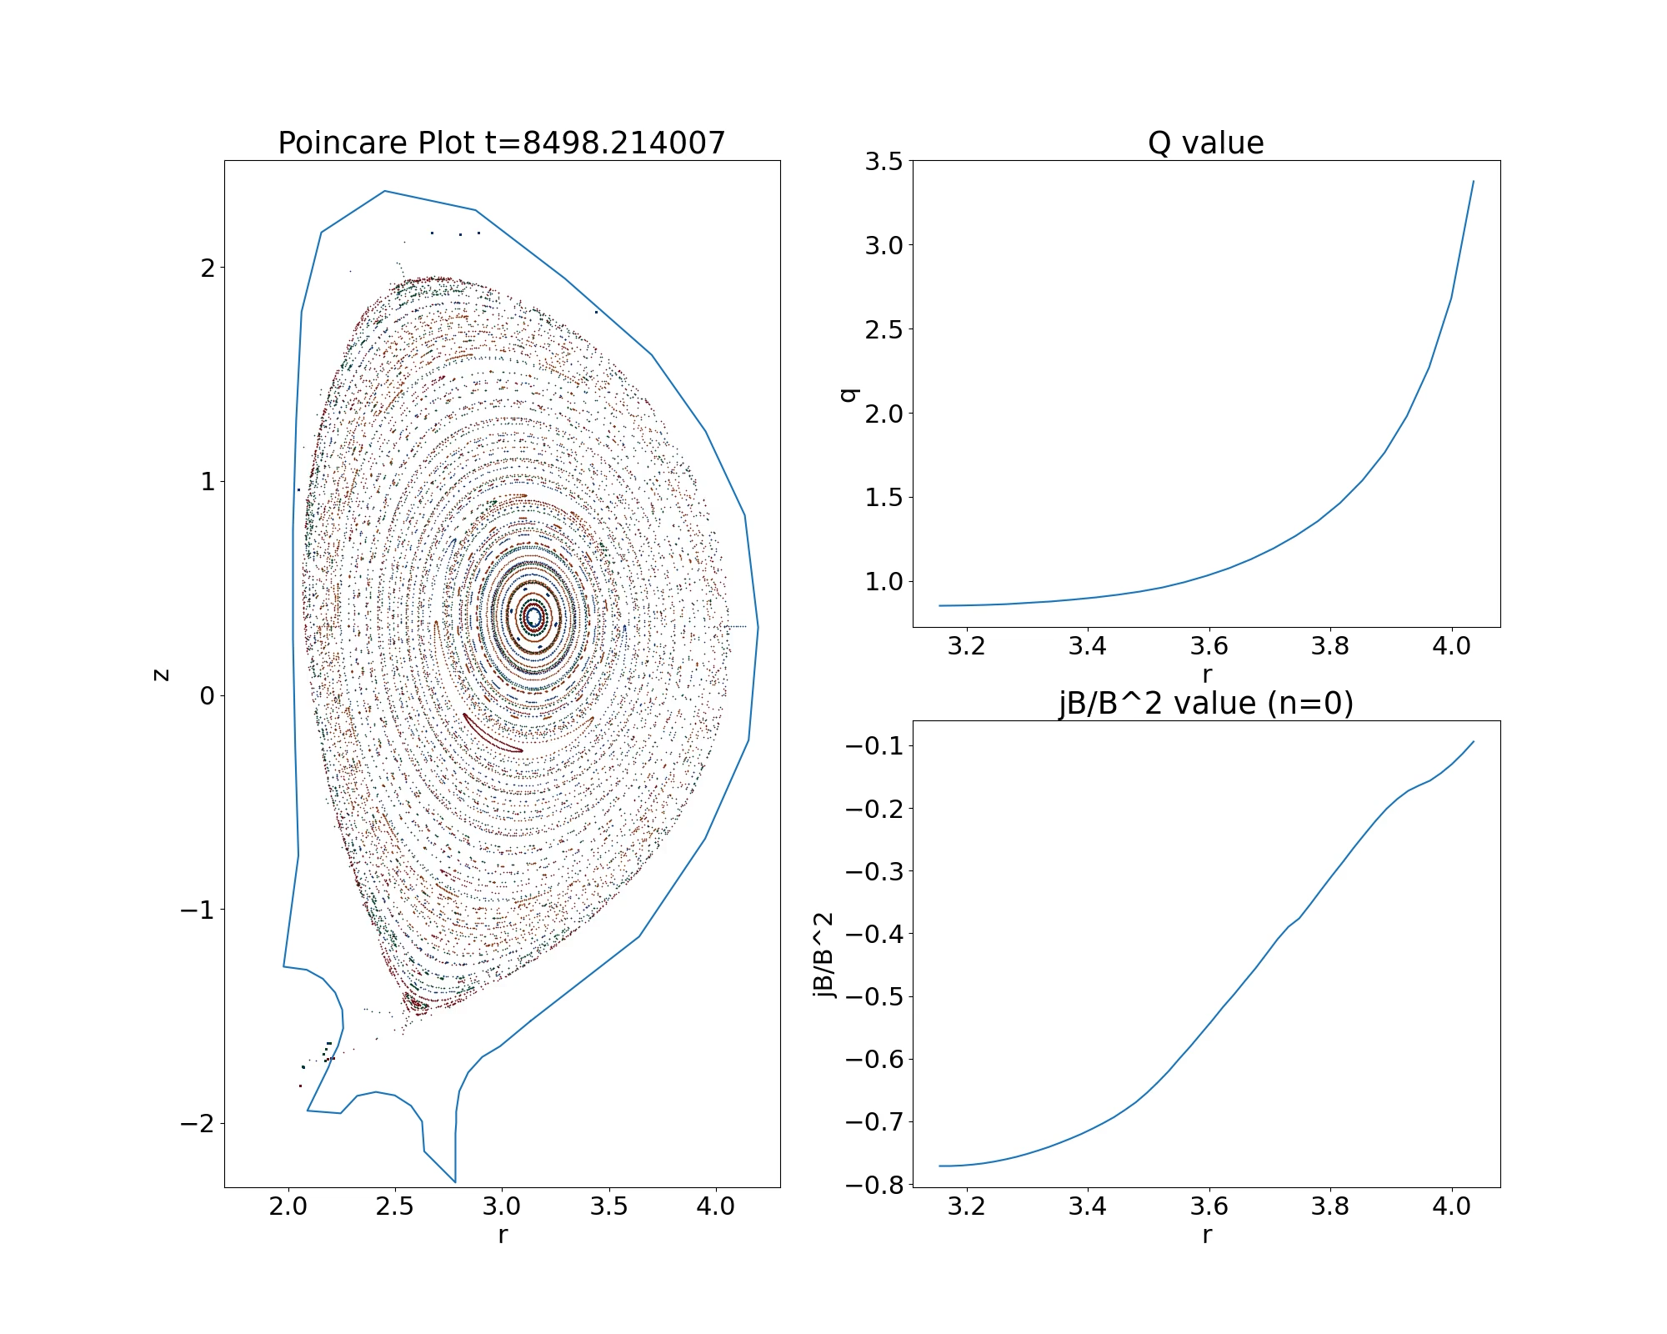
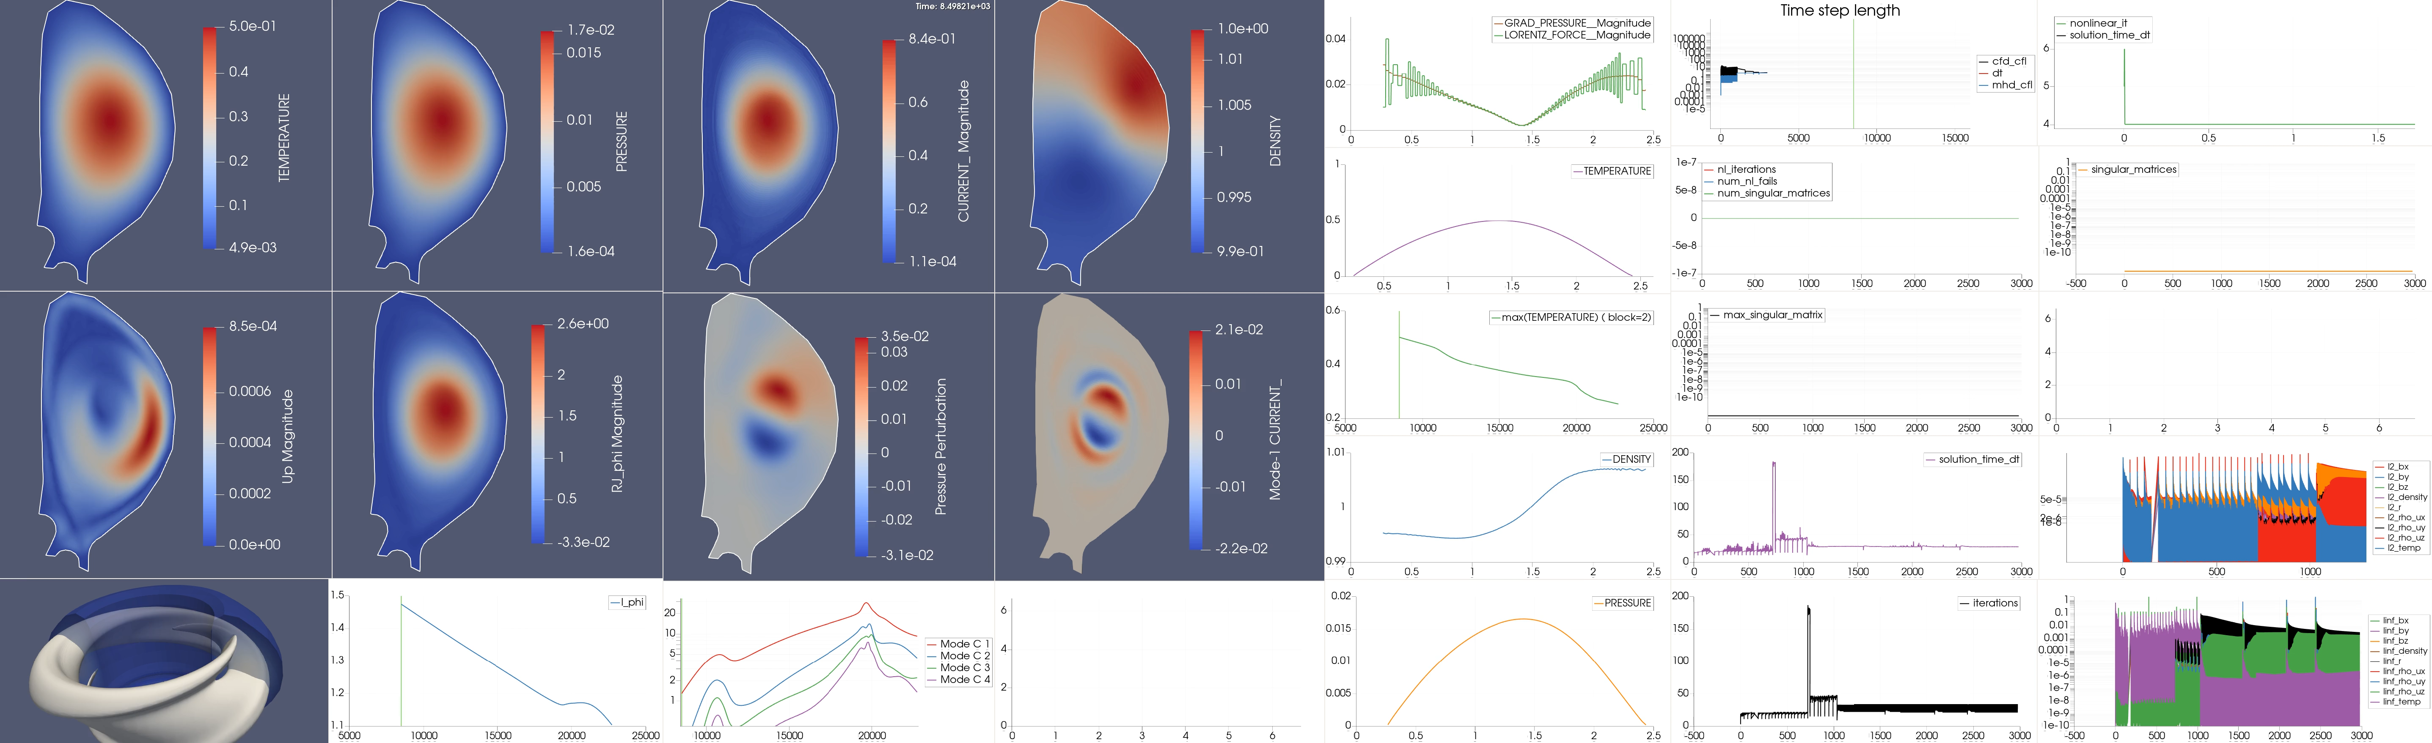
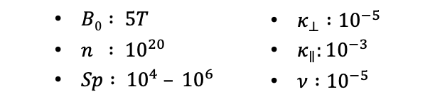
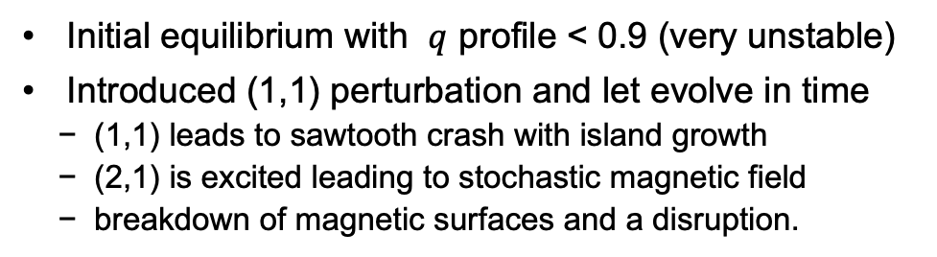
Internal kink
Initial equilibrium with $q$ profile < 0.9 (very unstable)
Introduced (1,1) perturbation and let evolve in time
(1,1) leads to sawtooth crash with island growth
(2,1) is excited leading to stochastic magnetic field
breakdown of magnetic surfaces and a disruption.
Return map of B to
Poloidal plane:
$B0 : 5T$
$n : {10}^{20}$
$Sp : {10}^{4} – {10}^{6}$
$κ_{⊥} :{10}^{−5}$
$κ_{∥}:{10}^{−3}$
$ν :{10}^{−5}$

Slide 14
Physics-based and Approximate Block Factorizations: Coercing Strongly Coupled Off- Diagonal Physics and/or Disparate Discretizations and Scalable Multigrid to play well together
Semi-discrete in time (e.g. BE):
Eliminate variable to parabolic form
Semi-discrete in time:
Approximate Block Factorizations & Schur-complements:
The resulting equation
The Schur complement is then
Recall: This is motivating how we develop preconditioners, not for developing solvers.
The NK method still seeks the solution to the original nonlinear/linear system residual!
[w/ L. Chacon (LANL) ]
Notes:
Schur Compliment of D2 in D1
%\frac{\partial u}{\partial t} = \frac{\partial v}{\partial x}~&,~~\frac{\partial v}{\partial t} = \frac{\partial u}{\partial x} \\
%u^{n+1} = u^n + \Delta t \frac{\partial v^{n+1}}{\partial x}~&,~~ v^{n+1} = v^n + \Delta t \frac{\partial u^{n+1}}{\partial x}
%(I - \beta \Delta t^2 \frac{\partial^2 }{\partial x^2})u^{n+1} = u^n + \Delta t \frac{\partial v^{n}}{\partial x}
%(I - \beta \Delta t^2 \mathcal{L}_{xx})u^{n+1} = \mathcal{F}^n
%\left[ \begin{array}{cc}
%D_1 & U \\
%L & D_2 \end{array} \right]
%=
%\left[ \begin{array}{cc}
%I & UD_2^{-1} \\
%0 & I \end{array} \right]
%\left[ \begin{array}{cc}
%D_1 - U D_2^{-1}L & 0 \\
%0 & D_2 \end{array} \right]
%\left[ \begin{array}{cc}
%I & 0 \\
%D_2^{-1} L & I \end{array} \right]
D_1 - U D_2^{-1}L = (I - \Delta t^2 C_x C_x) = (I - \Delta t^2 \mathcal{L}_{xx})

Slide 15
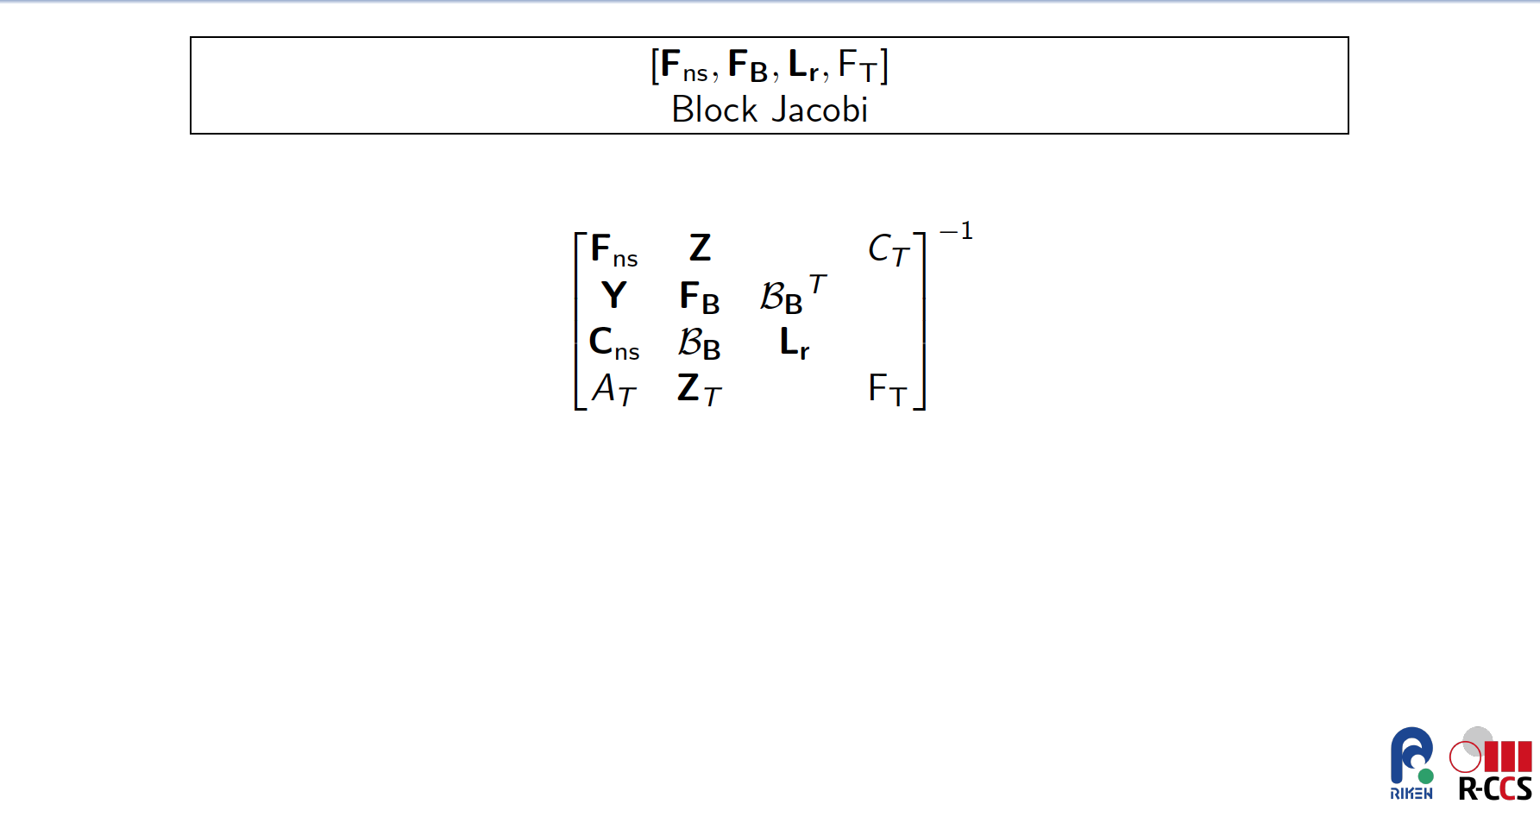
Notes:
MHD couples a Navier-Stokes type system for the ion momentum, mass conservation and energy to Maxwell’s equations.
Faraday’s law and Ampere’s Law (neglecting displacement currents) and a generalized Ohm’s law for the electric field.
7 waves
{\bf R_u} = \noindent \rho \frac{\partial {\bf u}}{\partial t} + \rho ({\bf u} \cdot \nabla {\bf u}) - \nabla \cdot ( {\bf T} + {\bf T}_{\bf M} ) -\rho {\bf g} = 0
{\bf R_u} = \frac{\partial \rho {\bf u}}{\partial t} + \nabla \cdot [ \rho {\bf u} \otimes {\bf u} - ({\bf T} + {\bf T}_M) ] + 2 \rho\Omega \times {\bf u} - \rho {\bf g} = {\bf 0}
R_P = \frac{\partial \rho}{\partial t} + \nabla \cdot (\rho {\bf u}) = 0
{\bf R_B} = \frac{\partial {\bf B}}{\partial t} -\nabla \times ({\bf u} \times {\bf B}) + \nabla \times ( \frac{\eta}{\mu_0} \nabla \times {\bf B}) = {\bf 0}.
{\bf T} & = & -P {\bf I} + {\bf \Pi} = -P {\bf I} - \frac{2}{3} \mu (\nabla \cdot {\bf u}) {\bf I} + \mu [\nabla {\bf u} + \nabla {\bf u}^T ]
{\bf T}_{\bf M} & = & \frac{1}{\mu_0} {\bf B} \otimes {\bf B} - \frac{1}{2 \mu_0} \| {\bf B} \|^2 {\bf I}
{\bf B} = \nabla \times {\bf A}
R_e = \frac{\partial (\rho e)}{\partial t} + \nabla \cdot \left[ \rho {\bf v} e + {\bf q} \right] - {{\bf T} : {\nabla {\bf v}}} - \eta \| {\frac{1}{\mu_0} \nabla \times {\bf B}} \|^2 = { 0}
R_{A_z} = \frac{\partial A_z}{\partial t} + {\bf u} \cdot \nabla A_z - \frac{\eta}{\mu_0} \nabla^2 A_z +E^0_z= 0.
%{\bf R_B} = \frac{\partial B}{\partial t} + \nabla \cdot \left[ {\bf u} \otimes {\bf B} - { \bf B} \otimes {\bf u} - \frac{\eta}{\mu_0} \left(\nabla {\bf B} - (\nabla {\bf B})^T) + \psi {\bf I} \right] = {\bf 0}
%R_{\psi} = \nabla \cdot {\bf B} = 0

Slide 16
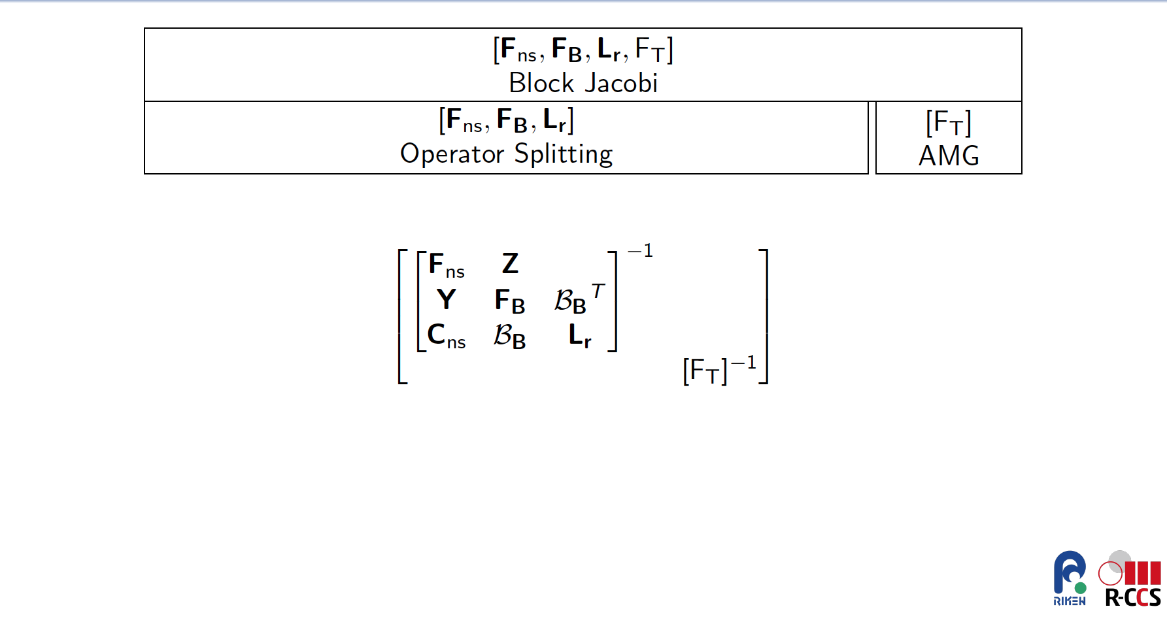
Notes:
MHD couples a Navier-Stokes type system for the ion momentum, mass conservation and energy to Maxwell’s equations.
Faraday’s law and Ampere’s Law (neglecting displacement currents) and a generalized Ohm’s law for the electric field.
7 waves
{\bf R_u} = \noindent \rho \frac{\partial {\bf u}}{\partial t} + \rho ({\bf u} \cdot \nabla {\bf u}) - \nabla \cdot ( {\bf T} + {\bf T}_{\bf M} ) -\rho {\bf g} = 0
{\bf R_u} = \frac{\partial \rho {\bf u}}{\partial t} + \nabla \cdot [ \rho {\bf u} \otimes {\bf u} - ({\bf T} + {\bf T}_M) ] + 2 \rho\Omega \times {\bf u} - \rho {\bf g} = {\bf 0}
R_P = \frac{\partial \rho}{\partial t} + \nabla \cdot (\rho {\bf u}) = 0
{\bf R_B} = \frac{\partial {\bf B}}{\partial t} -\nabla \times ({\bf u} \times {\bf B}) + \nabla \times ( \frac{\eta}{\mu_0} \nabla \times {\bf B}) = {\bf 0}.
{\bf T} & = & -P {\bf I} + {\bf \Pi} = -P {\bf I} - \frac{2}{3} \mu (\nabla \cdot {\bf u}) {\bf I} + \mu [\nabla {\bf u} + \nabla {\bf u}^T ]
{\bf T}_{\bf M} & = & \frac{1}{\mu_0} {\bf B} \otimes {\bf B} - \frac{1}{2 \mu_0} \| {\bf B} \|^2 {\bf I}
{\bf B} = \nabla \times {\bf A}
R_e = \frac{\partial (\rho e)}{\partial t} + \nabla \cdot \left[ \rho {\bf v} e + {\bf q} \right] - {{\bf T} : {\nabla {\bf v}}} - \eta \| {\frac{1}{\mu_0} \nabla \times {\bf B}} \|^2 = { 0}
R_{A_z} = \frac{\partial A_z}{\partial t} + {\bf u} \cdot \nabla A_z - \frac{\eta}{\mu_0} \nabla^2 A_z +E^0_z= 0.
%{\bf R_B} = \frac{\partial B}{\partial t} + \nabla \cdot \left[ {\bf u} \otimes {\bf B} - { \bf B} \otimes {\bf u} - \frac{\eta}{\mu_0} \left(\nabla {\bf B} - (\nabla {\bf B})^T) + \psi {\bf I} \right] = {\bf 0}
%R_{\psi} = \nabla \cdot {\bf B} = 0

Slide 17
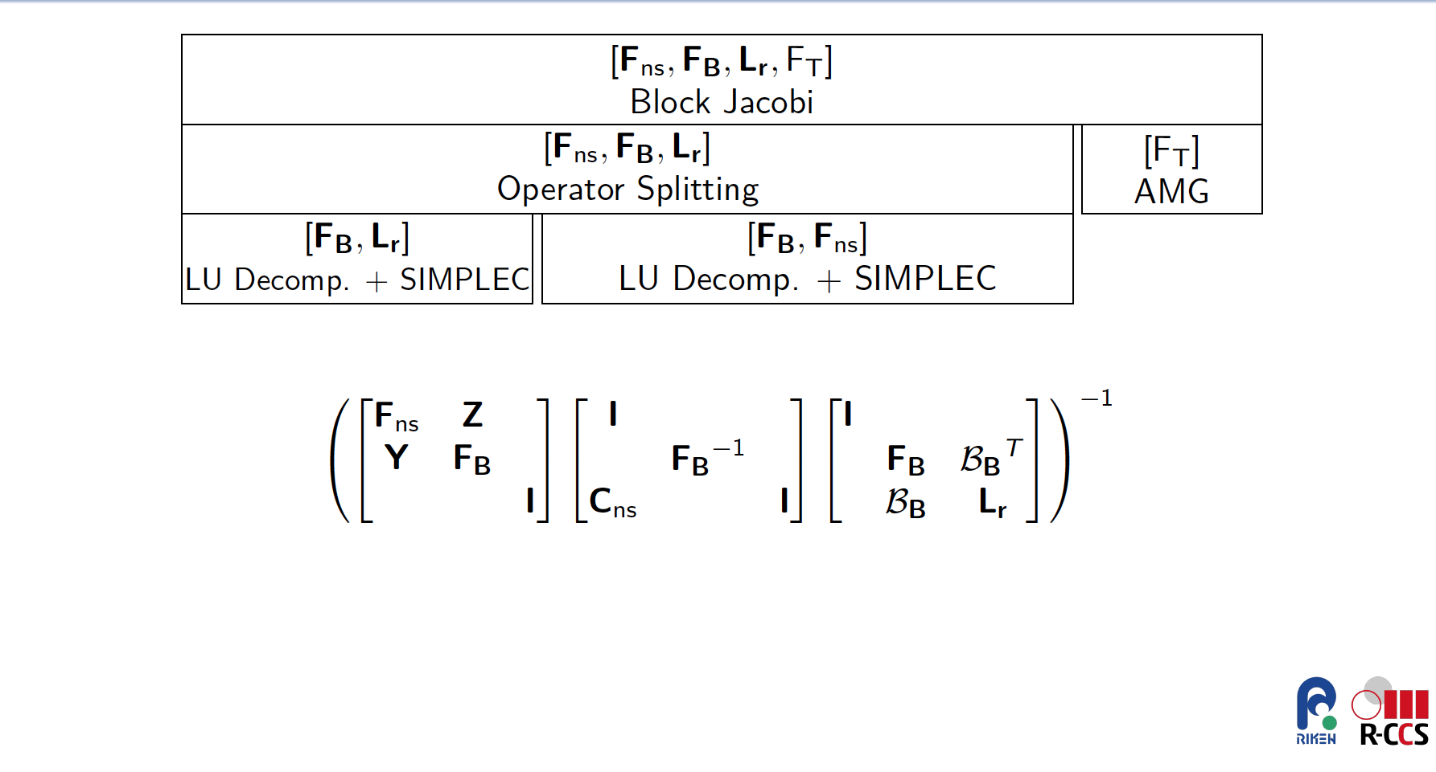
2x2 critical implicit Stiff Alfven wave coupling
2x2 Saddle point system for (B,r)
Notes:
MHD couples a Navier-Stokes type system for the ion momentum, mass conservation and energy to Maxwell’s equations.
Faraday’s law and Ampere’s Law (neglecting displacement currents) and a generalized Ohm’s law for the electric field.
7 waves
{\bf R_u} = \noindent \rho \frac{\partial {\bf u}}{\partial t} + \rho ({\bf u} \cdot \nabla {\bf u}) - \nabla \cdot ( {\bf T} + {\bf T}_{\bf M} ) -\rho {\bf g} = 0
{\bf R_u} = \frac{\partial \rho {\bf u}}{\partial t} + \nabla \cdot [ \rho {\bf u} \otimes {\bf u} - ({\bf T} + {\bf T}_M) ] + 2 \rho\Omega \times {\bf u} - \rho {\bf g} = {\bf 0}
R_P = \frac{\partial \rho}{\partial t} + \nabla \cdot (\rho {\bf u}) = 0
{\bf R_B} = \frac{\partial {\bf B}}{\partial t} -\nabla \times ({\bf u} \times {\bf B}) + \nabla \times ( \frac{\eta}{\mu_0} \nabla \times {\bf B}) = {\bf 0}.
{\bf T} & = & -P {\bf I} + {\bf \Pi} = -P {\bf I} - \frac{2}{3} \mu (\nabla \cdot {\bf u}) {\bf I} + \mu [\nabla {\bf u} + \nabla {\bf u}^T ]
{\bf T}_{\bf M} & = & \frac{1}{\mu_0} {\bf B} \otimes {\bf B} - \frac{1}{2 \mu_0} \| {\bf B} \|^2 {\bf I}
{\bf B} = \nabla \times {\bf A}
R_e = \frac{\partial (\rho e)}{\partial t} + \nabla \cdot \left[ \rho {\bf v} e + {\bf q} \right] - {{\bf T} : {\nabla {\bf v}}} - \eta \| {\frac{1}{\mu_0} \nabla \times {\bf B}} \|^2 = { 0}
R_{A_z} = \frac{\partial A_z}{\partial t} + {\bf u} \cdot \nabla A_z - \frac{\eta}{\mu_0} \nabla^2 A_z +E^0_z= 0.
%{\bf R_B} = \frac{\partial B}{\partial t} + \nabla \cdot \left[ {\bf u} \otimes {\bf B} - { \bf B} \otimes {\bf u} - \frac{\eta}{\mu_0} \left(\nabla {\bf B} - (\nabla {\bf B})^T) + \psi {\bf I} \right] = {\bf 0}
%R_{\psi} = \nabla \cdot {\bf B} = 0

Slide 18
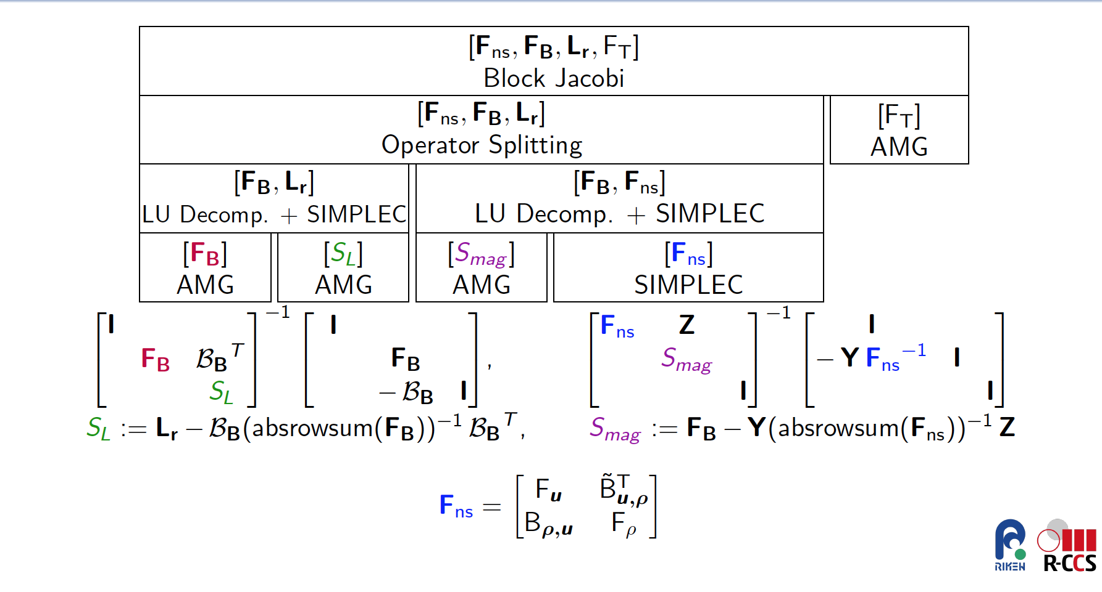
Notes:
MHD couples a Navier-Stokes type system for the ion momentum, mass conservation and energy to Maxwell’s equations.
Faraday’s law and Ampere’s Law (neglecting displacement currents) and a generalized Ohm’s law for the electric field.
7 waves
{\bf R_u} = \noindent \rho \frac{\partial {\bf u}}{\partial t} + \rho ({\bf u} \cdot \nabla {\bf u}) - \nabla \cdot ( {\bf T} + {\bf T}_{\bf M} ) -\rho {\bf g} = 0
{\bf R_u} = \frac{\partial \rho {\bf u}}{\partial t} + \nabla \cdot [ \rho {\bf u} \otimes {\bf u} - ({\bf T} + {\bf T}_M) ] + 2 \rho\Omega \times {\bf u} - \rho {\bf g} = {\bf 0}
R_P = \frac{\partial \rho}{\partial t} + \nabla \cdot (\rho {\bf u}) = 0
{\bf R_B} = \frac{\partial {\bf B}}{\partial t} -\nabla \times ({\bf u} \times {\bf B}) + \nabla \times ( \frac{\eta}{\mu_0} \nabla \times {\bf B}) = {\bf 0}.
{\bf T} & = & -P {\bf I} + {\bf \Pi} = -P {\bf I} - \frac{2}{3} \mu (\nabla \cdot {\bf u}) {\bf I} + \mu [\nabla {\bf u} + \nabla {\bf u}^T ]
{\bf T}_{\bf M} & = & \frac{1}{\mu_0} {\bf B} \otimes {\bf B} - \frac{1}{2 \mu_0} \| {\bf B} \|^2 {\bf I}
{\bf B} = \nabla \times {\bf A}
R_e = \frac{\partial (\rho e)}{\partial t} + \nabla \cdot \left[ \rho {\bf v} e + {\bf q} \right] - {{\bf T} : {\nabla {\bf v}}} - \eta \| {\frac{1}{\mu_0} \nabla \times {\bf B}} \|^2 = { 0}
R_{A_z} = \frac{\partial A_z}{\partial t} + {\bf u} \cdot \nabla A_z - \frac{\eta}{\mu_0} \nabla^2 A_z +E^0_z= 0.
%{\bf R_B} = \frac{\partial B}{\partial t} + \nabla \cdot \left[ {\bf u} \otimes {\bf B} - { \bf B} \otimes {\bf u} - \frac{\eta}{\mu_0} \left(\nabla {\bf B} - (\nabla {\bf B})^T) + \psi {\bf I} \right] = {\bf 0}
%R_{\psi} = \nabla \cdot {\bf B} = 0

Slide 19
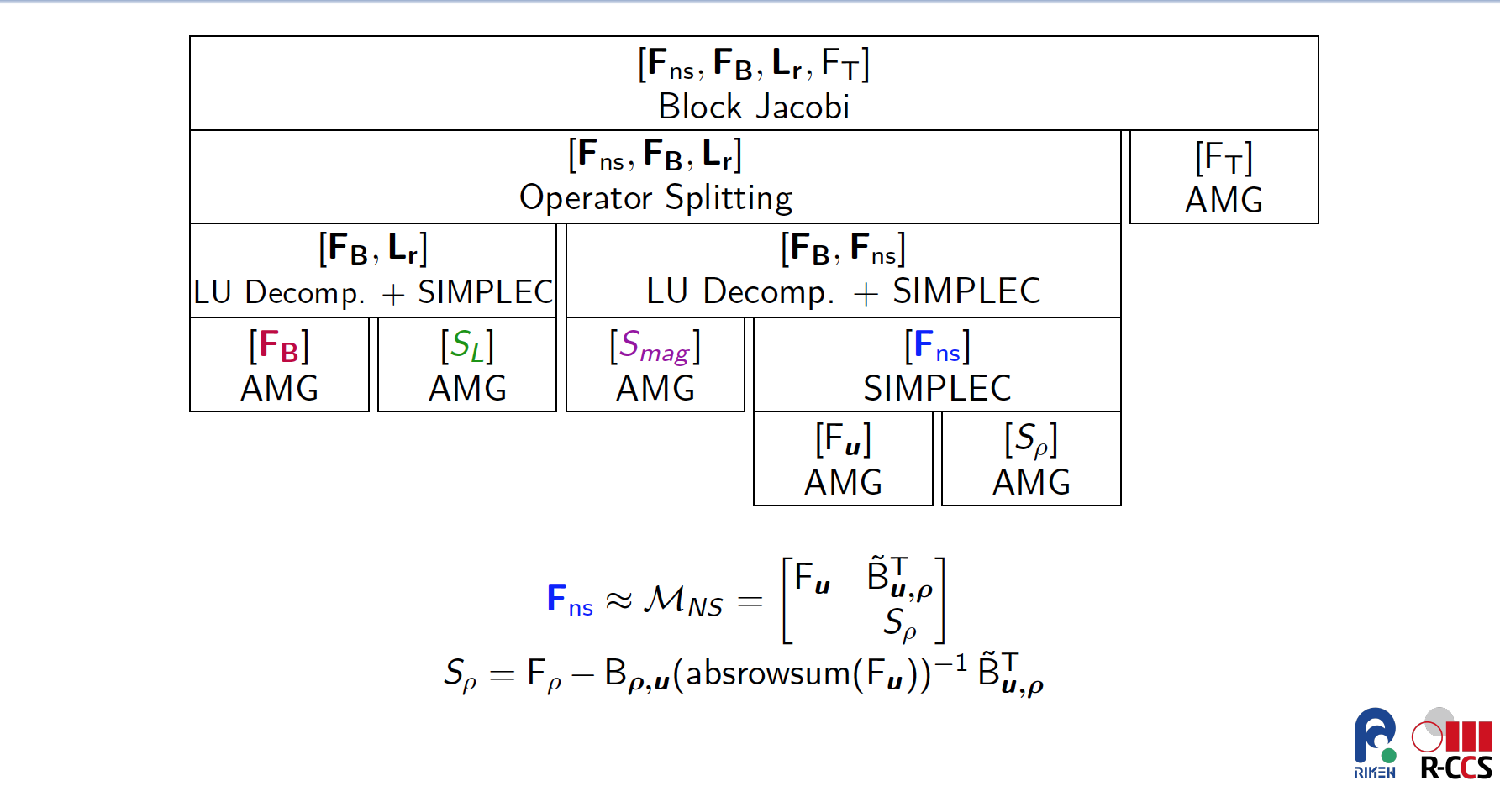
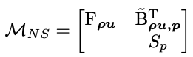
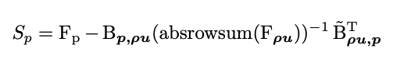
Notes:
MHD couples a Navier-Stokes type system for the ion momentum, mass conservation and energy to Maxwell’s equations.
Faraday’s law and Ampere’s Law (neglecting displacement currents) and a generalized Ohm’s law for the electric field.
7 waves
{\bf R_u} = \noindent \rho \frac{\partial {\bf u}}{\partial t} + \rho ({\bf u} \cdot \nabla {\bf u}) - \nabla \cdot ( {\bf T} + {\bf T}_{\bf M} ) -\rho {\bf g} = 0
{\bf R_u} = \frac{\partial \rho {\bf u}}{\partial t} + \nabla \cdot [ \rho {\bf u} \otimes {\bf u} - ({\bf T} + {\bf T}_M) ] + 2 \rho\Omega \times {\bf u} - \rho {\bf g} = {\bf 0}
R_P = \frac{\partial \rho}{\partial t} + \nabla \cdot (\rho {\bf u}) = 0
{\bf R_B} = \frac{\partial {\bf B}}{\partial t} -\nabla \times ({\bf u} \times {\bf B}) + \nabla \times ( \frac{\eta}{\mu_0} \nabla \times {\bf B}) = {\bf 0}.
{\bf T} & = & -P {\bf I} + {\bf \Pi} = -P {\bf I} - \frac{2}{3} \mu (\nabla \cdot {\bf u}) {\bf I} + \mu [\nabla {\bf u} + \nabla {\bf u}^T ]
{\bf T}_{\bf M} & = & \frac{1}{\mu_0} {\bf B} \otimes {\bf B} - \frac{1}{2 \mu_0} \| {\bf B} \|^2 {\bf I}
{\bf B} = \nabla \times {\bf A}
R_e = \frac{\partial (\rho e)}{\partial t} + \nabla \cdot \left[ \rho {\bf v} e + {\bf q} \right] - {{\bf T} : {\nabla {\bf v}}} - \eta \| {\frac{1}{\mu_0} \nabla \times {\bf B}} \|^2 = { 0}
R_{A_z} = \frac{\partial A_z}{\partial t} + {\bf u} \cdot \nabla A_z - \frac{\eta}{\mu_0} \nabla^2 A_z +E^0_z= 0.
%{\bf R_B} = \frac{\partial B}{\partial t} + \nabla \cdot \left[ {\bf u} \otimes {\bf B} - { \bf B} \otimes {\bf u} - \frac{\eta}{\mu_0} \left(\nabla {\bf B} - (\nabla {\bf B})^T) + \psi {\bf I} \right] = {\bf 0}
%R_{\psi} = \nabla \cdot {\bf B} = 0

Slide 20
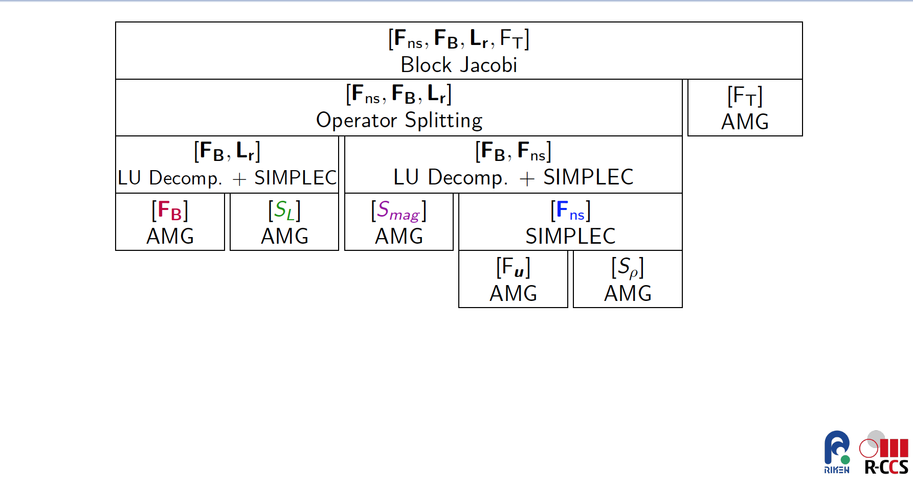
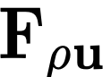
(B,r) saddle point problem for
Nearly incompressible flow saddle point problem
Stiff Alfven Wave Coupling
Notes:
MHD couples a Navier-Stokes type system for the ion momentum, mass conservation and energy to Maxwell’s equations.
Faraday’s law and Ampere’s Law (neglecting displacement currents) and a generalized Ohm’s law for the electric field.
7 waves
{\bf R_u} = \noindent \rho \frac{\partial {\bf u}}{\partial t} + \rho ({\bf u} \cdot \nabla {\bf u}) - \nabla \cdot ( {\bf T} + {\bf T}_{\bf M} ) -\rho {\bf g} = 0
{\bf R_u} = \frac{\partial \rho {\bf u}}{\partial t} + \nabla \cdot [ \rho {\bf u} \otimes {\bf u} - ({\bf T} + {\bf T}_M) ] + 2 \rho\Omega \times {\bf u} - \rho {\bf g} = {\bf 0}
R_P = \frac{\partial \rho}{\partial t} + \nabla \cdot (\rho {\bf u}) = 0
{\bf R_B} = \frac{\partial {\bf B}}{\partial t} -\nabla \times ({\bf u} \times {\bf B}) + \nabla \times ( \frac{\eta}{\mu_0} \nabla \times {\bf B}) = {\bf 0}.
{\bf T} & = & -P {\bf I} + {\bf \Pi} = -P {\bf I} - \frac{2}{3} \mu (\nabla \cdot {\bf u}) {\bf I} + \mu [\nabla {\bf u} + \nabla {\bf u}^T ]
{\bf T}_{\bf M} & = & \frac{1}{\mu_0} {\bf B} \otimes {\bf B} - \frac{1}{2 \mu_0} \| {\bf B} \|^2 {\bf I}
{\bf B} = \nabla \times {\bf A}
R_e = \frac{\partial (\rho e)}{\partial t} + \nabla \cdot \left[ \rho {\bf v} e + {\bf q} \right] - {{\bf T} : {\nabla {\bf v}}} - \eta \| {\frac{1}{\mu_0} \nabla \times {\bf B}} \|^2 = { 0}
R_{A_z} = \frac{\partial A_z}{\partial t} + {\bf u} \cdot \nabla A_z - \frac{\eta}{\mu_0} \nabla^2 A_z +E^0_z= 0.
%{\bf R_B} = \frac{\partial B}{\partial t} + \nabla \cdot \left[ {\bf u} \otimes {\bf B} - { \bf B} \otimes {\bf u} - \frac{\eta}{\mu_0} \left(\nabla {\bf B} - (\nabla {\bf B})^T) + \psi {\bf I} \right] = {\bf 0}
%R_{\psi} = \nabla \cdot {\bf B} = 0

Slide 21
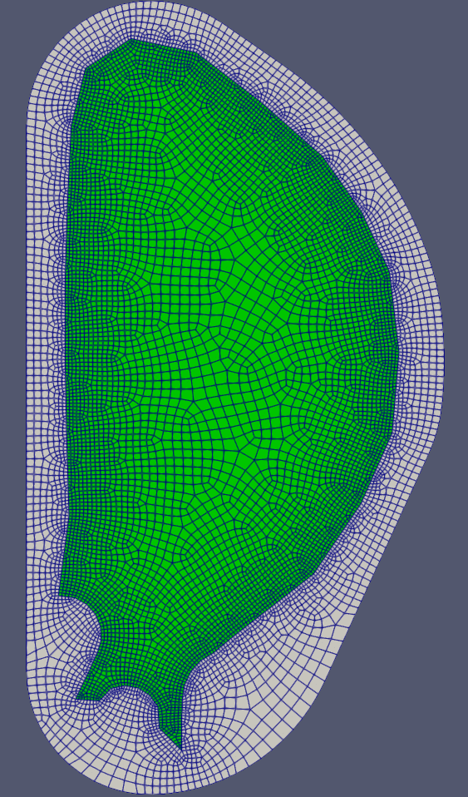
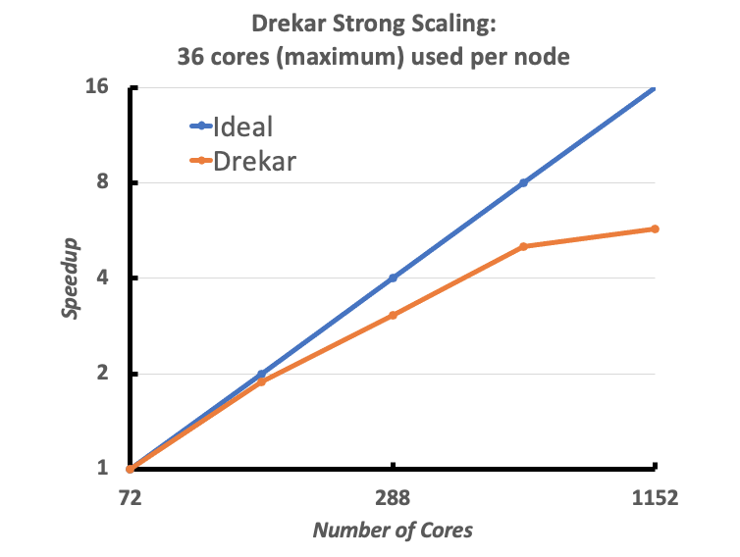
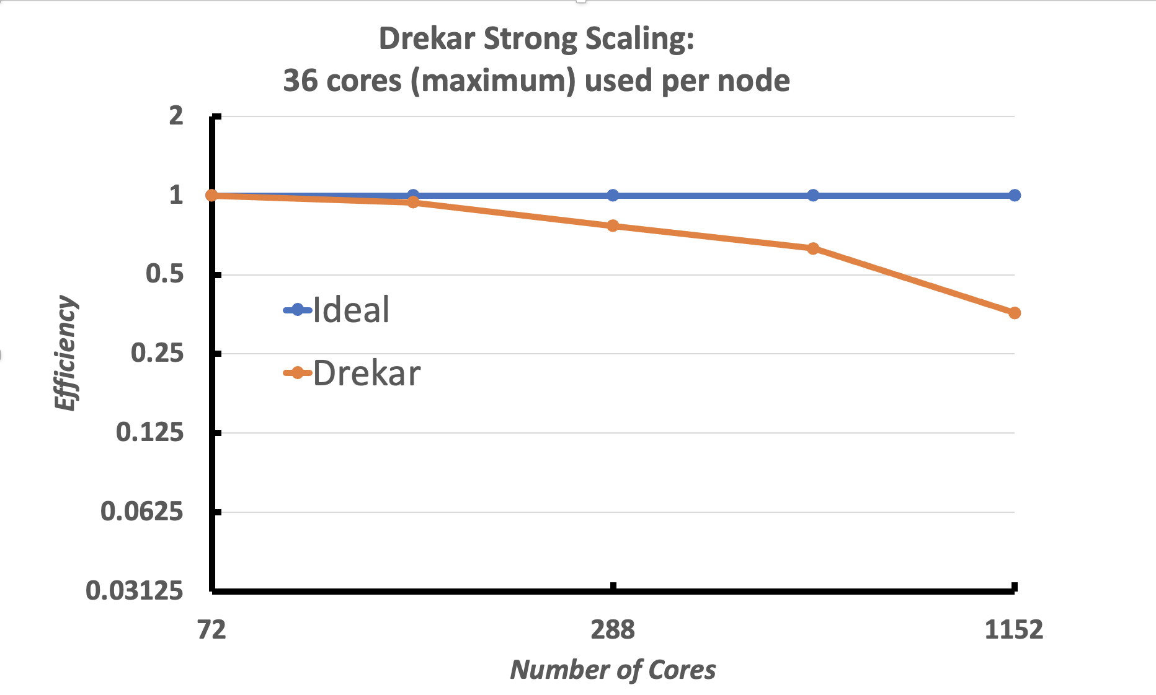
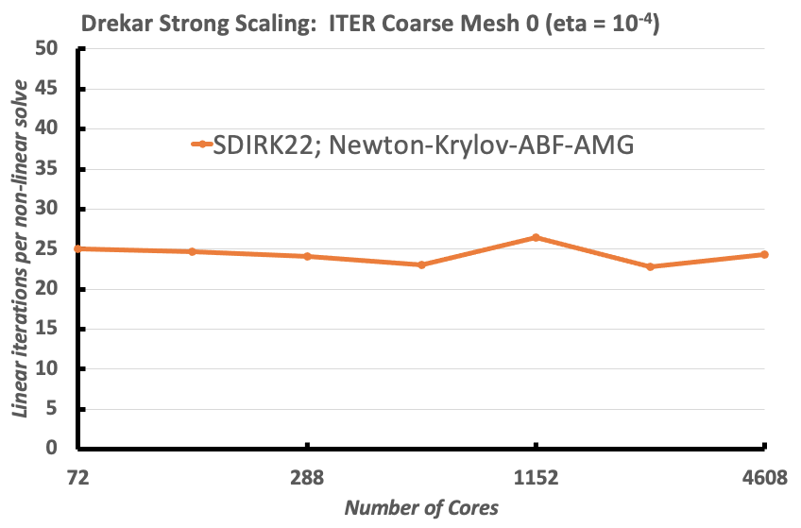
Drekar Strong Scaling Results 3D ITER VDE
Strong scaling unperturbed initial equilibrium on coarse mesh with S = 1e4.
To 250 global Alfven times. 72 cores → 4608 cores (64x increase).
Coarse Mesh 0: 347K elements, 7.2K poloidal x 48 toroidal
Constant time-step size dt = 2
Max CFL_{A} ~ 750, CFL_{u} ~3.2
16x cores
64x
Notes:
mesh 0. : 347K elements, 7.2K poloidal x 48 toroidal, 108 cores on ghost
*mesh 0.5: 1.27M elements, 9.9K poloidal x 128 toroidal, ? cores on ghost
mesh 1. : 2.77M elements, 28.8K poloidal x 96 toroidal, 864 cores on ghost
mesh 2. : 22.2M elements,115.2K poloidal x 192 toroidal, 9612 cores on ghost

Slide 22
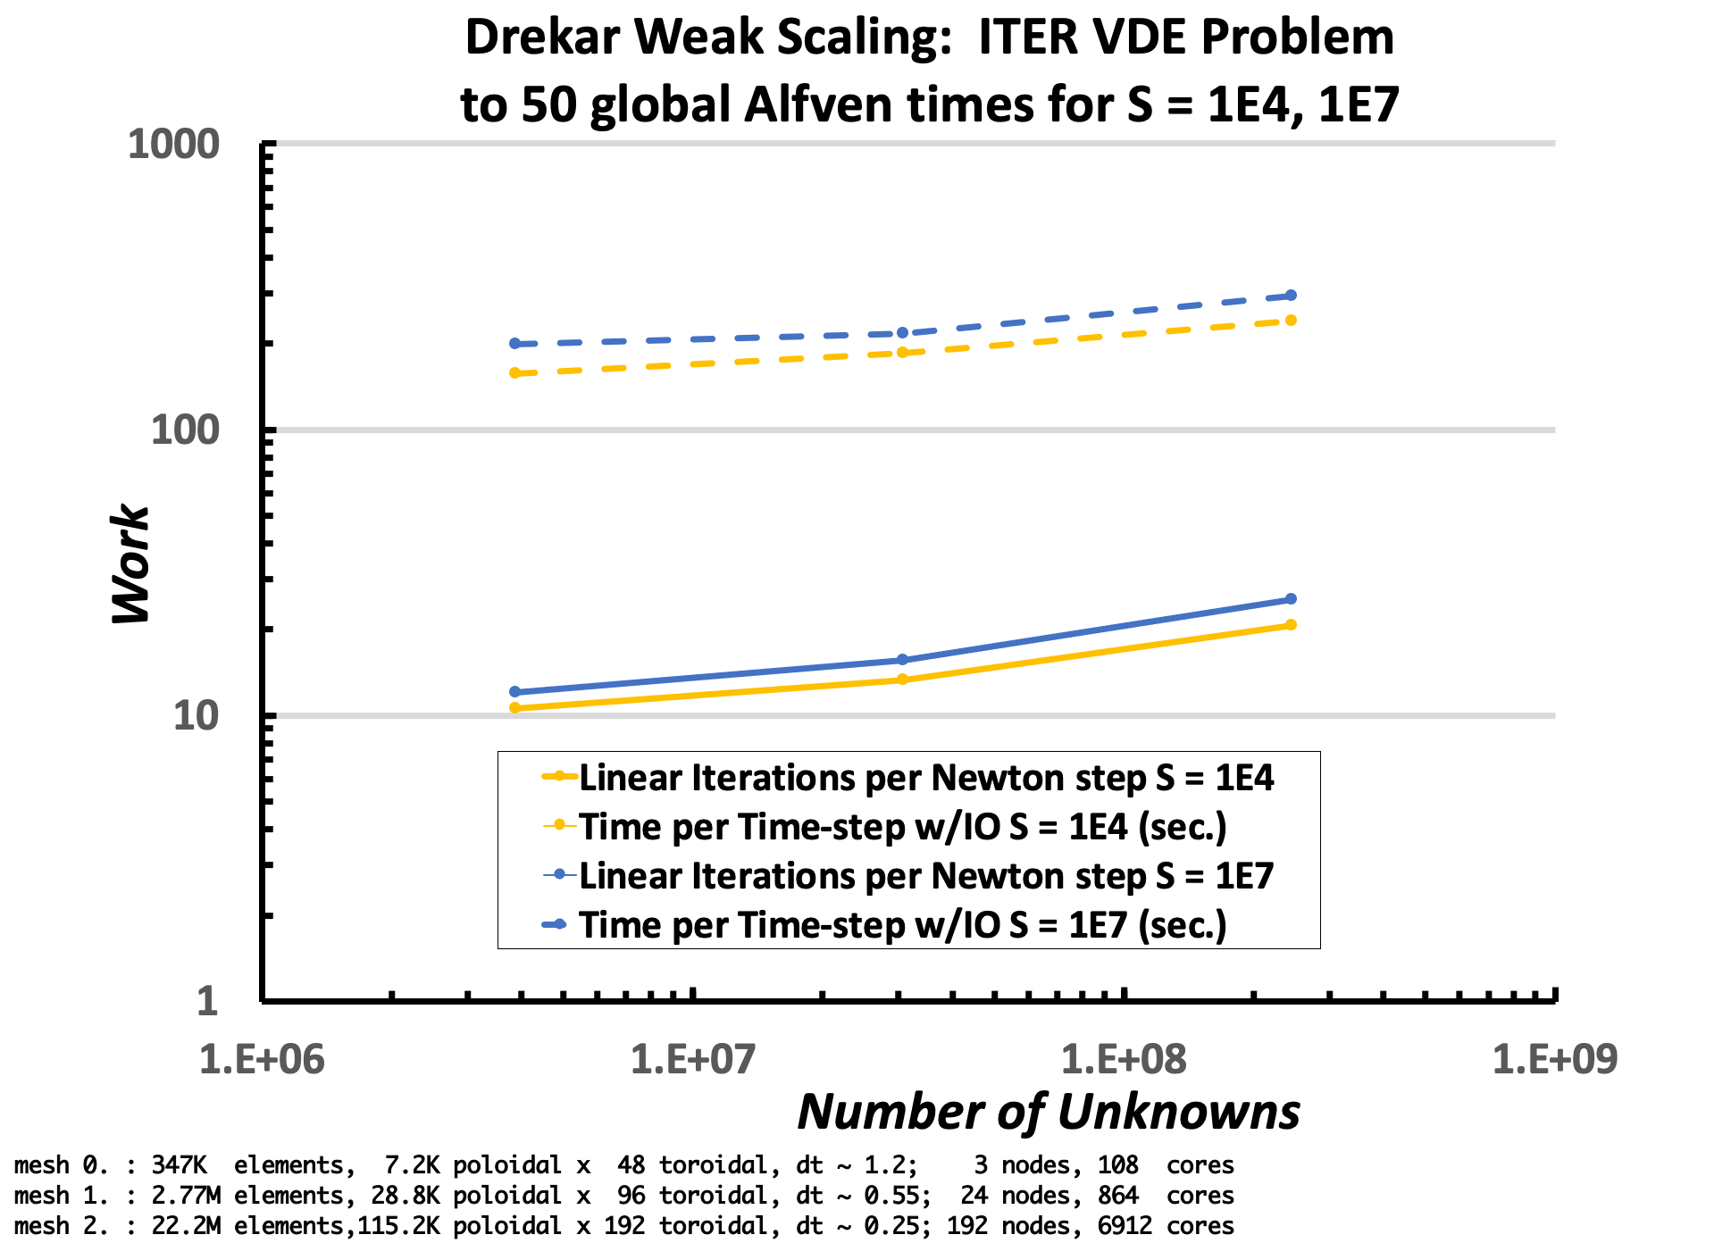
Drekar Weak scaling Study 3D ITER VDE
64x unknowns, cores
192 nodes,
6912 cores
3 nodes,
108 cores
24 nodes,
864 cores
Unstructured mesh sequence
To 50 global Alfven times
Max CFL_{A} = 400, CFL_{u} = 2
mesh 0. : 347K elements, 7.2K poloidal x 48 toroidal, dt ~ 1.2; 108 cores on ghost
mesh 1. : 2.77M elements, 28.8K poloidal x 96 toroidal, dt ~ 0.55; 864 cores on ghost
mesh 2. : 22.2M elements,115.2K poloidal x 192 toroidal, dt ~ 0.25; 6912 cores on ghost
Pr_{m} = 0.1, Pr_{T} = 1

Slide 23
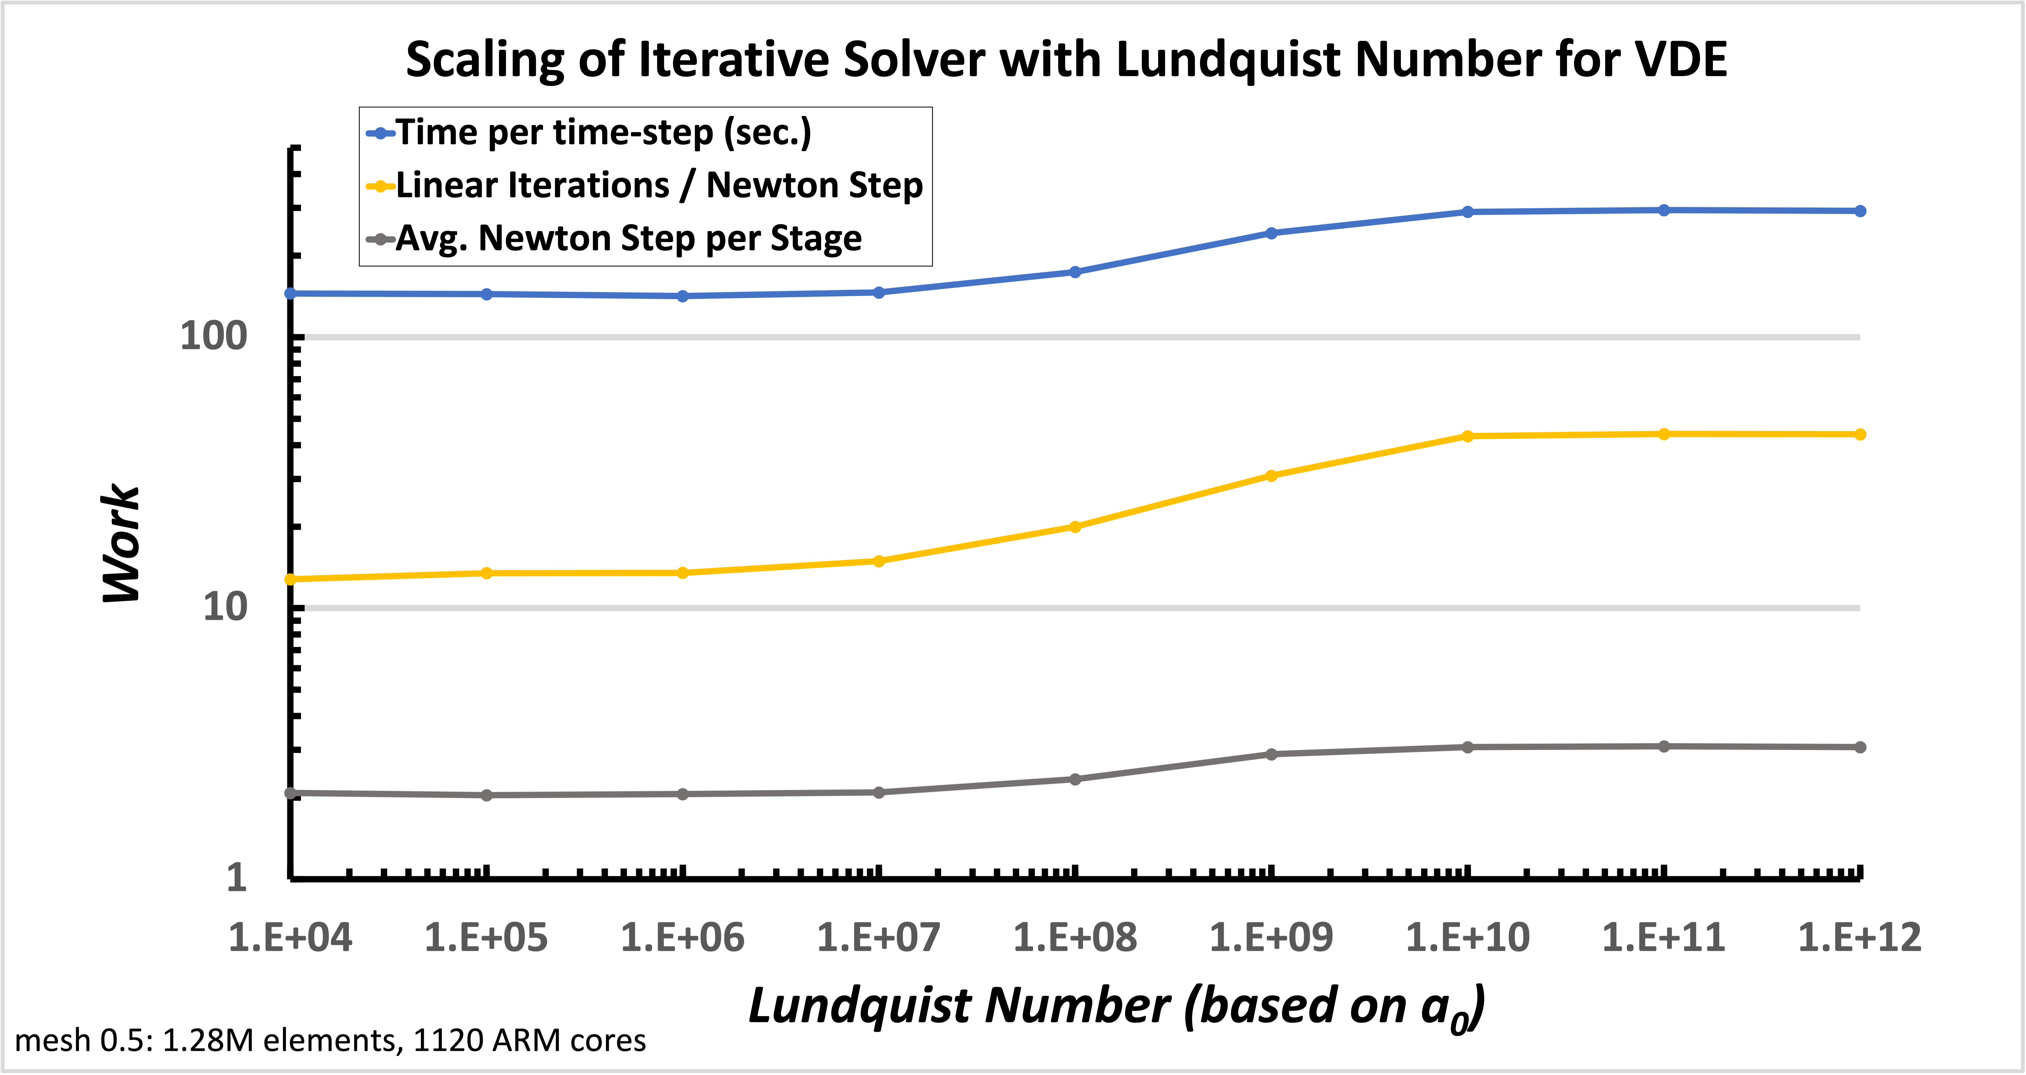
Lundquist Number scaling, coarse mesh 0.5 to 25 global Alfven times.
(Pr_{m} = 10, Pr_{T} = 1 i.e. both momentum and thermal diffusivities the same, scale 10x resistivity )
Mesh 0.5: 1.28M elements,10K poloidal x 128 toroidal, 1120 ARM cores
To 25 global Alfven times
Max CFL_{A} = 400, CFL_{u} = 2
dt ~ 1.0

Slide 24
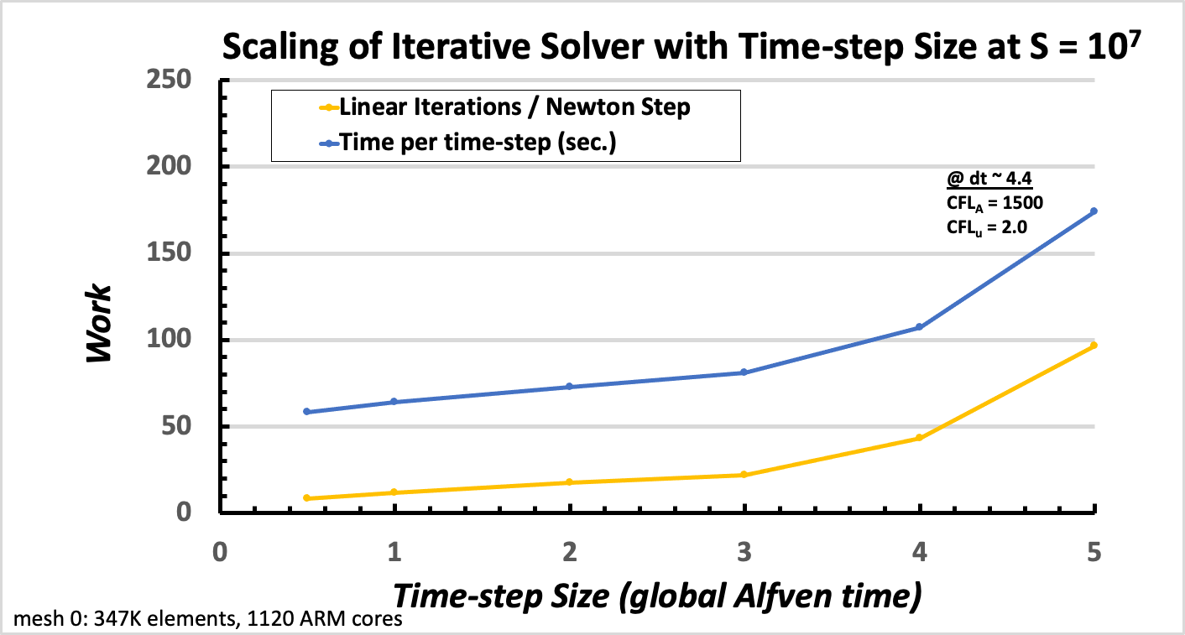
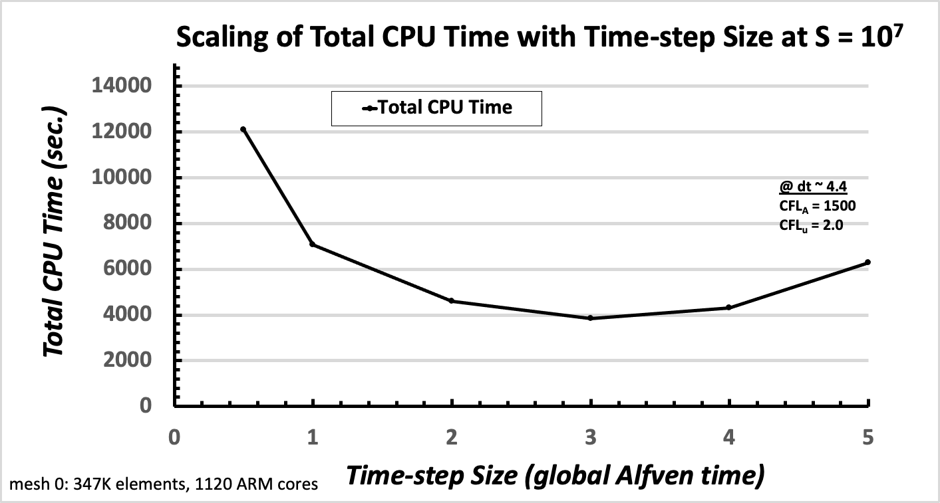
Time-step Size scaling for S = 10⁷ ^{Coarse mesh0}
To 100 global Alfven times

Slide 25
Conclusions
Developed scalable fully implicit low Mach compressible visco-resistive MHD solver.
Stabilized FE formulation → definite linear system and solvability (demonstated numerically)
Approximate block factorization → scalable treatment of multiphysics equation coupling.
Scalable AMG solves → efficient scalable sub-block preconditioning.
Demonstrated scalability (strong and weak), Lundquist number robustness, promising initial efficiency for longer-time scale simulations.
Proof-of-principle numerical experiments.
Cold VDE.
(1,1) internal kink mode.
Future work
Further V&V benchmarks.
Extension to two temperature models (T_{i}, T_{e}).
Notes:
1
R&A Confirmed
Your request has been submitted for review and approval. Your tracking (document) number is: 5314153.

Slide 26


Tokamak Disruption Simulation (TDS) SciDAC Center
DOE Office of Science
ASCR/OFES SciDAC-4 Partnership (FY18 – FY23)
Xianzhu Tang (Lead – DOE PI, LANL PI)
J Shadid (DOE ASCR – PI, SNL PI)

